Slide 1
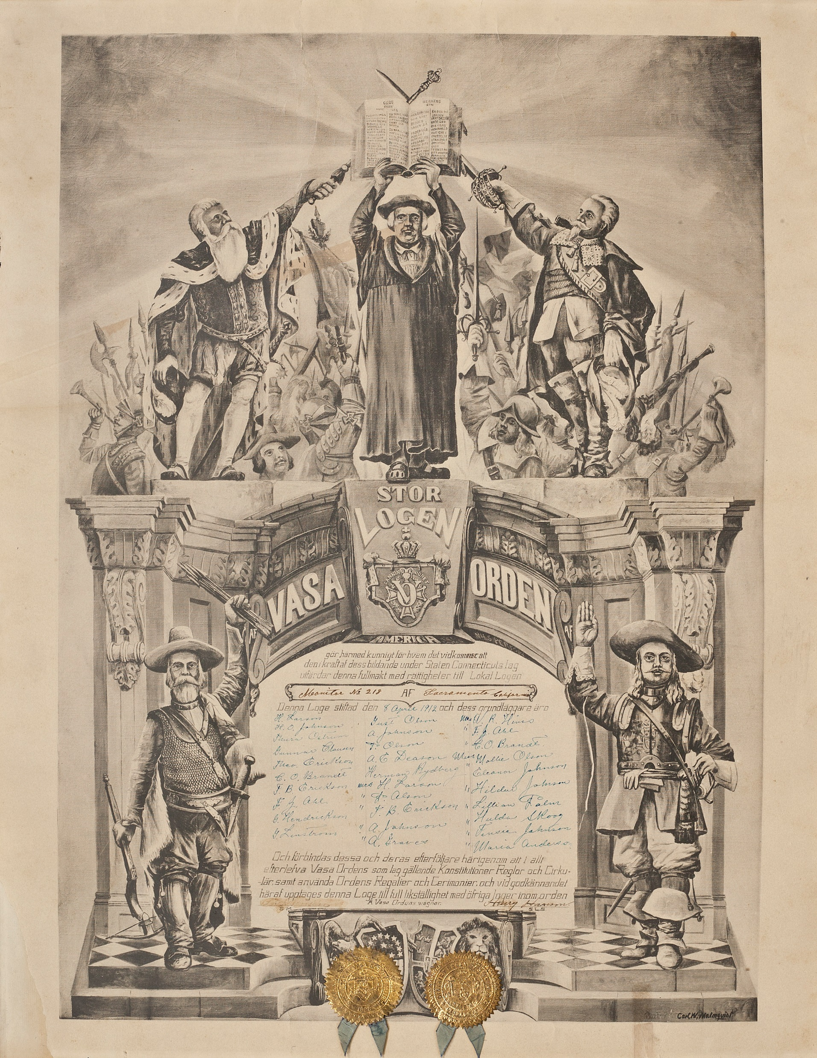
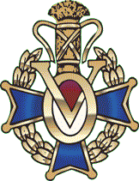
VASA Order of America Monitor Lodge #218 charter signed April 8, 1912

Slide 2
The Grand Lodge charter was designed by C W Malmquist, who also selected the phrasing, at the first Grand Lodge convention. The early Vasa Charters use the old Swedish spellings that were changed to the modern spellings in 1907.

Slide 3
The identity of the prelate is not known although there were several well known prelates in Gustav’s, Fleming’s and Malmquist’s respective eras. He is holding the Ten Commandments and “Fader Var” (Our Lord’s Prayer)

Slide 4
King Gustav I, the first of the VASA family line, is holding a royal septer and he is the origin of the VASA Order of America name. Between Gustav and the priest is the wheat sheaf banner we all have in our local lodges.

Slide 5
Admiral Clas Fleming is holding a ceremonial navy cutlass. The admiral was a major force behind the settlement of New Sweden. The Swedish flag is between the priest and the admiral.

Slide 6
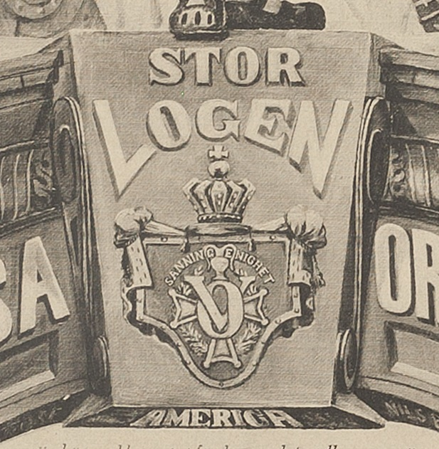
Looking the VOA emblem at the center of the charter and the source of the VASA membership pin you will see the words: Sanning Enighet - Truth and Unity
The letters "V" and "0“ and the colors red, white and blue stand for the Vasa Order of America. The Maltese cross stands for Generosity, the wreath depicts Truth, and the sheaf symbolizes Unity while the ermine mantle and regal crown, alonmg with the phrase “Stor Logan” signifies the highest authority of the Order - the Grand Lodge.

Slide 7
VASA Charter A rough translations follows:

Slide 8
Gör harmed kunnigt for hvem det vid kammer alt den I kraftaf dess bildende under Staten Connecticuts lag ulfärdar denna fullmakt med rättigheler till Lokal Logen
Make known to whom by the Chamber all that it forces for its formation under State Connecticut's Law, this power of attorney with rights to Local Lodge
Denna Loge stiftad den 8 April 1912 och dess grundläggare äro
This Lodge was founded on April 8, 1912 and its founders are:

Slide 9
Och förbindas dessa och deras efterföljare häringenom att I allt efterlefva Vasa Orden som lag gällande Konstitutioner Reglor och Cirkulär, samt använda Ordens Regalier och Cerimonier, och vid godkännandel här upptage denna Loge till full likställighet med öfriga loger inom orden
A Vasa Ordens wägnar.
And these and their followers are bound to remind you that you all abide by the Vasa Order as a Constitution Rule and Circular Law, and use the Regalia and Ceremonies of the Word, and upon approval here, this Lodge fully corresponds with other lodges within the words.
A Vasa Order Ways.

Slide 10
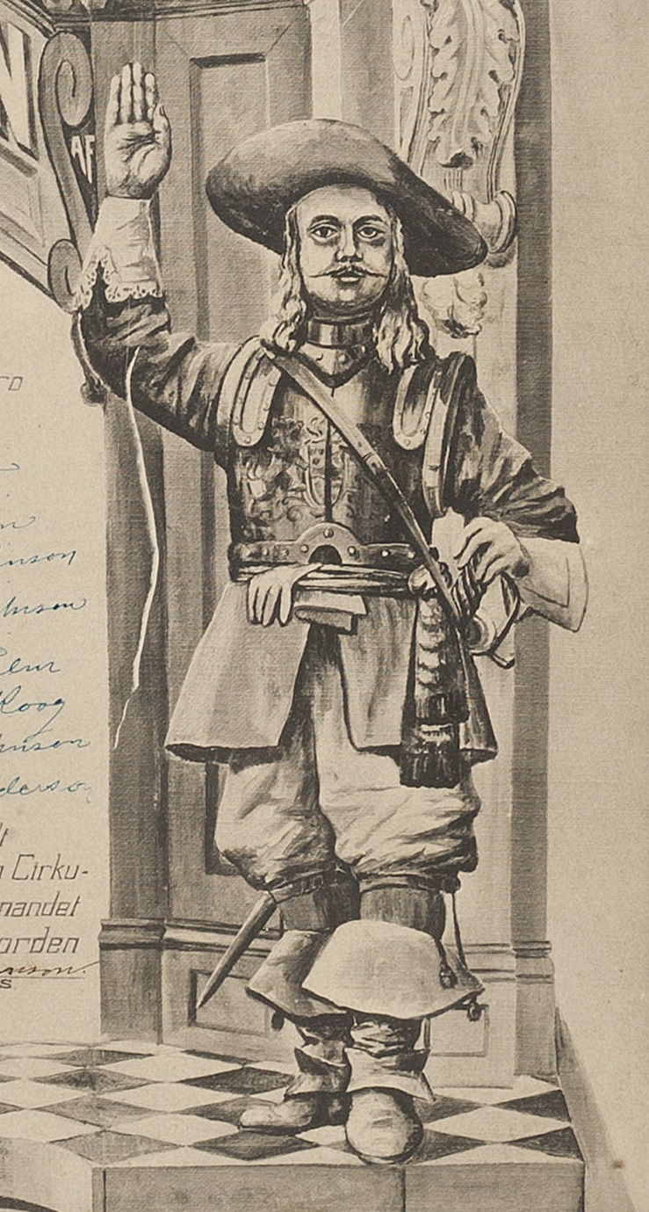
While the identity of these two figures is not known with certainty, it is likely that they are Peter Minut and Samuel Blommaert , men who along with Admiral Fleming, played key roles in the establishment of New Sweden.

Slide 11
The Bald Eagle is behind the American shield and the Swedish Lion is behind the Swedish shield. Both are under the gold seals.

Slide 12
The Symbolism of the Vasa Emblem says "[CW Malmquist] was born in Varmland Sweden in 1861 and came to the US in 1882 at the age of 21. He was an artist, steel engraver and printer. At the very first meeting of the Grand Lodge, he was appointed to draw up a design for the emblem, charters and other official forms for the Order. At the next Grand Lodge meeting held at New Haven, CT in March 1899, his drawings and designs were accepted and became official. Malmquist became the 3rd GM and was bestowed with the honor of Honorary Life Membership of the Order."

