Slide 1
The Swedish Warship WASA

Slide 2
“You don’t need Dramamine for this sailing adventure”
We are all familiar with Sweden’s most famous ship, the Wasa, which suffered calamity on its maiden voyage, sailing less than a mile before sinking inside Stockholm harbor in 1628. But are you familiar with many other, some famous and some mundane, Swedish sailing ships?

Slide 3
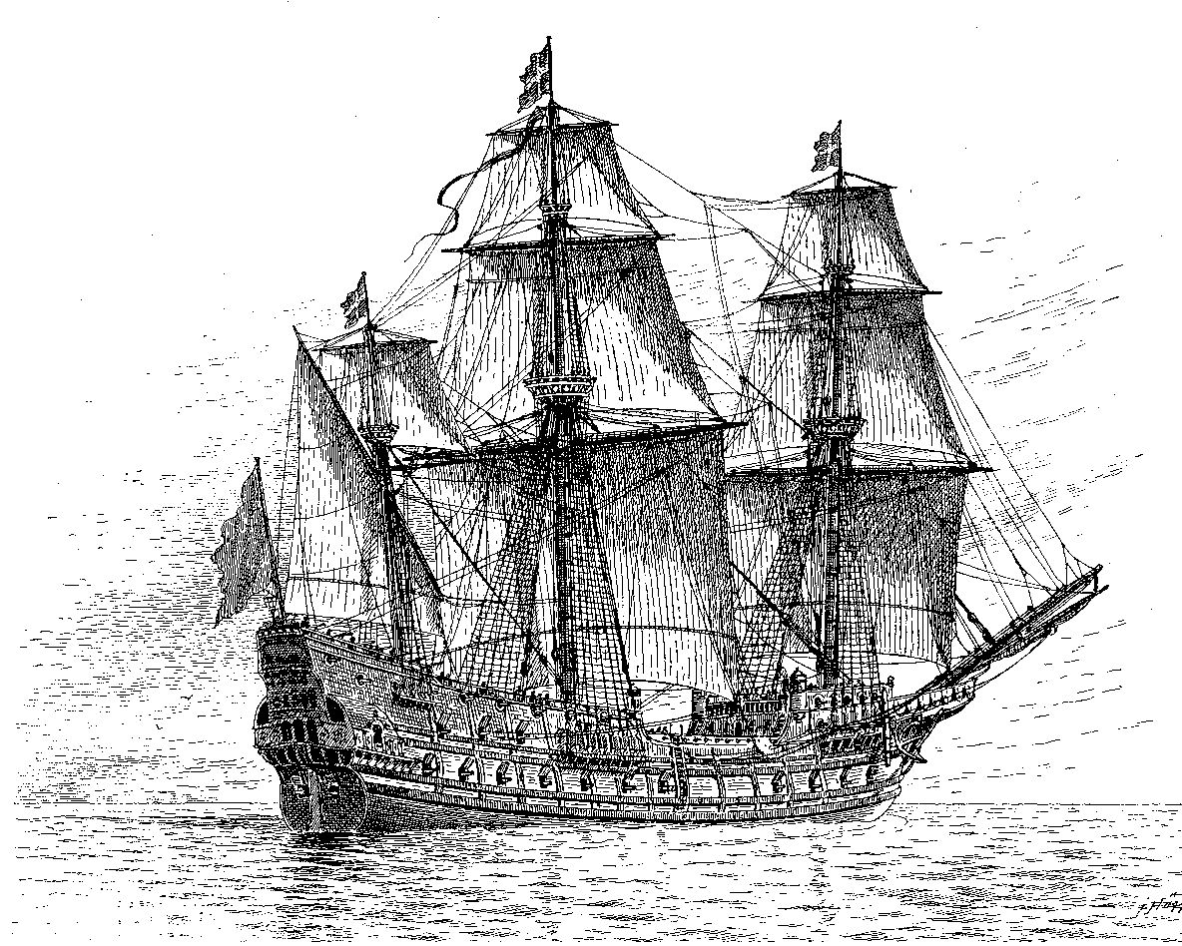
1564
Mars, also known as Makalös ("peerless; astounding") was a Swedish warship that was built between 1563 and 1564. It was the leading ship of king Eric XIV of Sweden's
fleet, and at 48 meters and, equipped with 107 guns, was one of the largest warships of the time, even larger than the famous Swedish ship Vasa. In 1564, during the Northern Seven Years' War, the ship caught fire and exploded during the first battle of Öland in the Baltic Sea. Mars has a place in the history of naval warfare for being the first ship to sink another ship with gunfire.

Slide 4
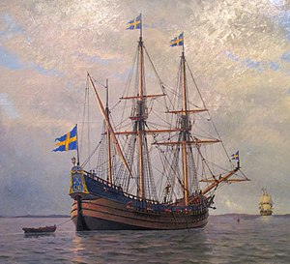
1625 Kalmar Nyckel (Key of Kalmar) was a Dutch-built armed merchant ship famed for carrying Swedish settlers to North America in 1638, to establish the colony of New Sweden. A replica of the ship was launched at Wilmington, DE in 1997

Slide 5
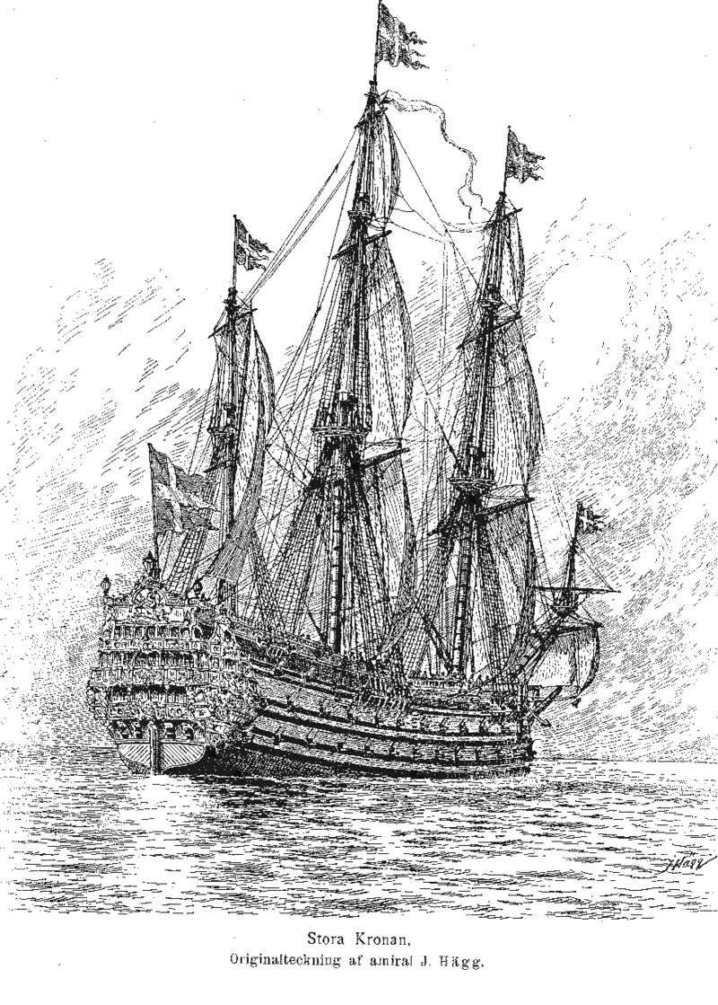
1665
Kronan, also called Stora Kronan, was a Swedish warship that served as the flagship of the Swedish Navy in the Baltic Sea in the 1670s. When built, she was one of the largest seagoing vessels in the world. After four years of service, the ship foundered in rough weather at the Battle of Öland on 1 June 1676. While making a sharp turn under too much sail she capsized, the gunpowder magazine ignited and blew off most of the bow. Kronan sank quickly, taking about 800 men and more than 100 guns with her, along with valuable military equipment, weapons, personal items, and large quantities of silver and gold coins. The loss of Kronan was a hard blow for Sweden during the Scanian War.

Slide 6
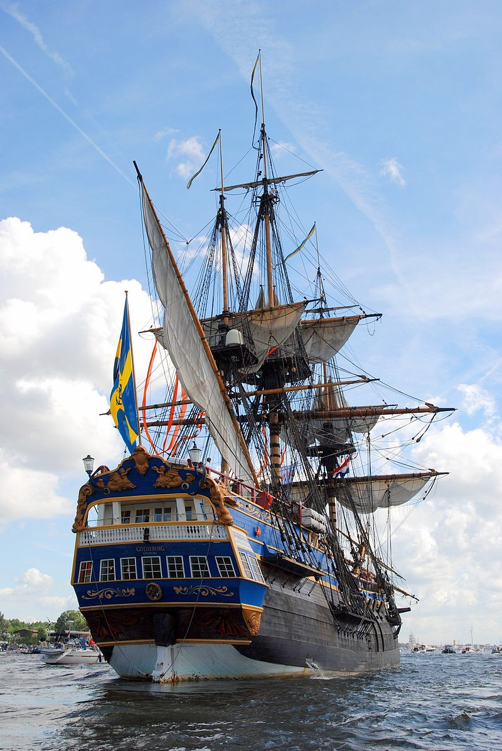
1738
Götheborg is a sailing replica of an 18th-century Swedish East Indiaman and one of the world's largest operational wooden sailing vessels. All sailors survived when the original ship sank off Gothenburg, Sweden, on 12 September 1745, while approaching the harbor on her return from a third voyage to China. Construction of the replica started in 1995, with the hull launched in 2003, and the rig fully tested for the first time in 2005. Much of the time was spent researching how to rebuild the replica. In 2008, Götheborg completed the first Baltic Sea Tour.

Slide 7
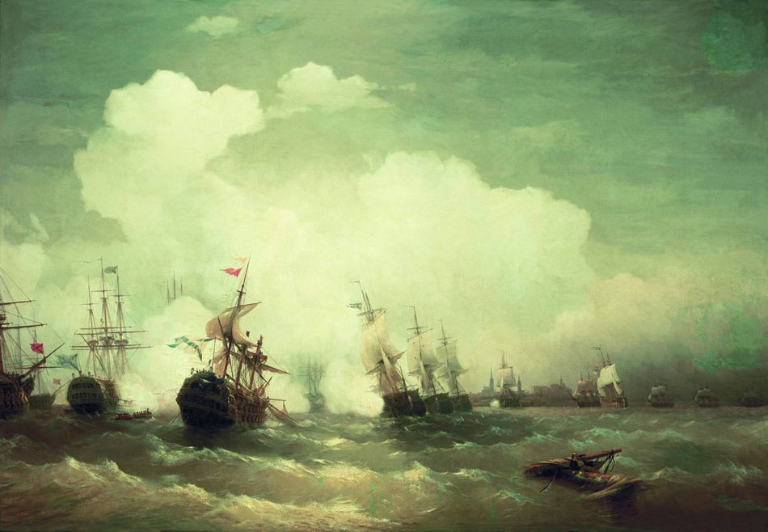
1789
HMS Ulla Fersen was a frigate of the Swedish Royal Navy, designed by Frederik H. Chapman, and launched in 1789. She served during the Russo-Swedish War (1788-1790), most notably at the Battle of Reval. British vessels twice detained her, once in 1798 and again in 1801, with the first event resulting in a major court case bearing on the meaning of neutrality. She was completely rebuilt in 1802, and lost in a storm in 1807.

Slide 8
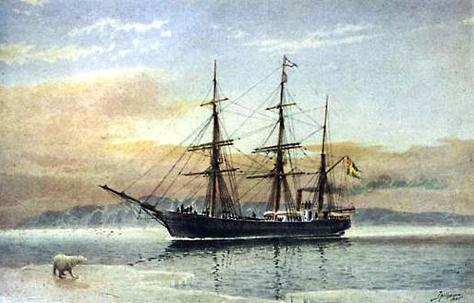
1872 SS Vega was a Swedish barque, built in Bremerhaven Germany in 1872. She was the first ship to complete a voyage through the Northeast Passage, and the first vessel to circumnavigate the Eurasian continent, during the Vega expedition.

Slide 9
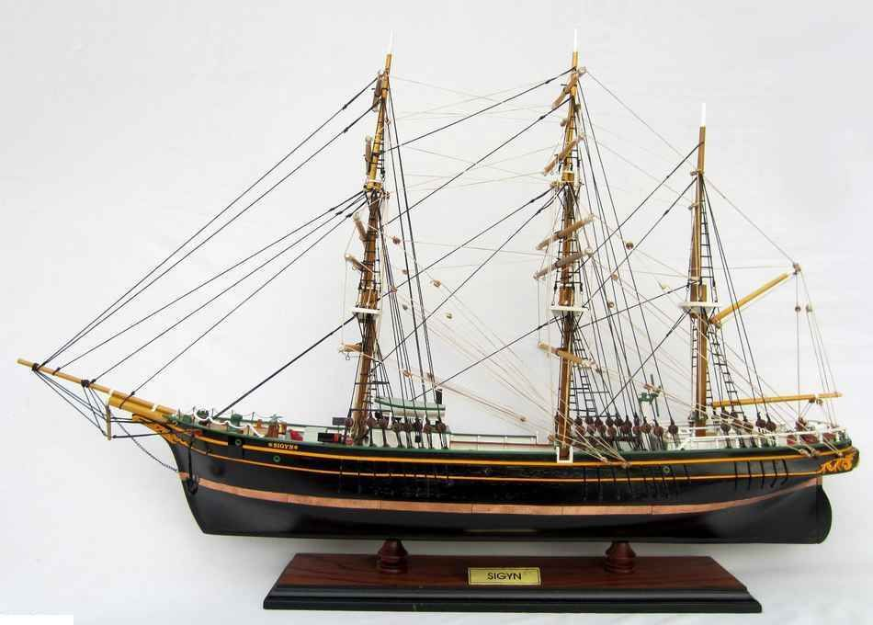
1887
Sigyn, built in Gothenburg 1887, now museum ship in Turku, is the last remaining wooden barque for trade across the oceans. At the time she was built there were thousands of similar vessels, but she was one of the last ones built. She was quite small even for her time, considering she was built for long-distance trade, but well built and considered fast and beautiful.

Slide 10
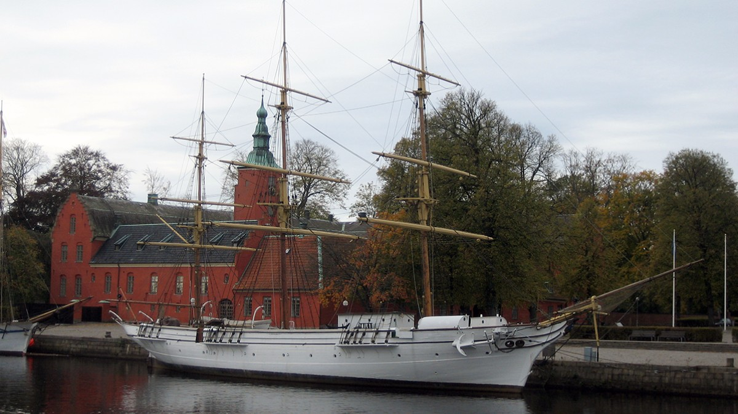
1897
HSwMS Najaden was a Swedish Navy training ship launched in 1897. The three-masted, wooden hulled sailing ship was constructed at the Royal Naval Shipyard in Karlskrona in 1897 and served in the Swedish Navy as a sail training ship until 1938. In 1946 she was taken over by the city of Halmstad, Sweden and restored. Najaden passed into Norwegian ownership in 2014 and now serves as a museum ship in Fredrikstad, Norway.

