Slide 1
The Nordic Museum is an internationally recognized museum and cultural center where people of all backgrounds are welcomed to be inspired by the values, traditions, art, and spirit of the Nordic peoples.
Dedicated to collecting, preserving, and educating since its founding in 1980, the Nordic Museum is the largest museum in the United States to honor the legacy of immigrants from the five Nordic countries: Denmark, Finland, Iceland, Norway, and Sweden.

Slide 3
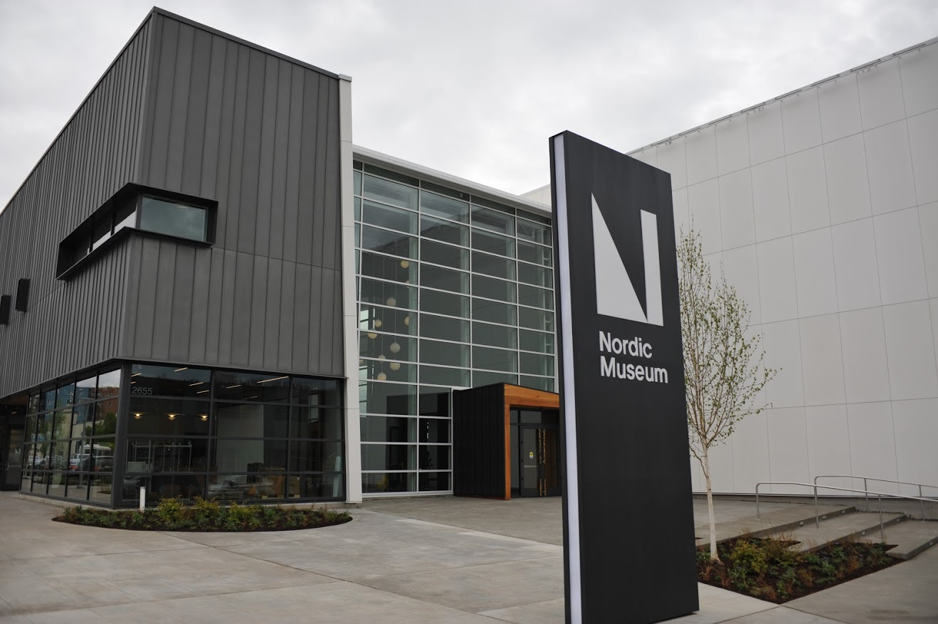
Nordic Museum main entrance – Seattle, Washington

Slide 4
Artist’s view of main entrance looking southeast

Slide 5
Artist’s view of main entrance looking to the east

Slide 6
Looking west in the main lobby with cafeteria in right back corner

Slide 7
Artist’s view of main lobby looking east past the membership desk towards Fjord Hall

Slide 8
Looking east from the main lobby into Fjord Hall with the sculptured map of Scandinavia on the south wall

Slide 9
The sculpture map of Scandinavia (Iceland, the Faroe Islands and Greenland are not visible in this photo). Photo by Chris Bodelson

Slide 10
Looking east into Fjord Hall with a view of some of the soaring seabird sculptures

Slide 11
Another view of Fjord Hall with a Faroe Islands boat on display

Slide 12
The piece is called Migration, by Tróndur Patursson

Slide 13
A closer view of the soaring seabird sculptures

Slide 14
.
Tróndur Patursson and his son Brandur working on installing the bird sculptures

Slide 15
Tróndur was born in the village of Kirkjubøur, on the Faroese island of Streymoy, where he still lives today.

Slide 16
Fishing - Nordic America Gallery

Slide 17
Logging - Nordic America Gallery

Slide 18
Immigration - Nordic America Gallery

Slide 19
Sami Artifacts- The Nordic Region Gallery

Slide 20
Country exhibit with nyckelharpa – Sweden Photo by Chris Bodelson

Slide 21
Country exhibit with Mora clock – Sweden Photo by Chris Bodelson

Slide 22
Nordic America – In to the Heartland

Slide 23
Nordic Forum room
Nordic Forum Room

Slide 24
Nordic Perspectives Forum

Slide 25
Nordic Perspectives Forum and wall map

Slide 26
Nordic Orientation video room

Slide 27
Nordic Spirit – port side view

Slide 28
Nordic Spirit – view from forward of the bow

Slide 29
Osberg Great Hall

Slide 30
The Nordic Regions Hall from across one of the bridges traversing Fjord Hall

Slide 31
The Nordic Region - Building National Identities

Slide 32
The Nordic Region - Middle Ages

Slide 33
The Nordic Region - Creating the Nordic Way

Slide 34
Viking Era_The Nordic Region_Adjusted

Slide 35
Viking Era - The Nordic Region

Slide 36
Sense of Place – continuous slide show of natural places in Scandinavia – Danish seascape

Slide 37
Sense of Place Gallery – notice the birch trees and boulder-like floor pillows – Norwegian fjord

Slide 38
Sense of Place – continuous slide show of natural places in Scandinavia – Danish landscape

Slide 39
Acknowledgements
Opening aerial image courtesy of Google Earth
Video and all photos and artist’s images not otherwise identified courtesy of Nordic Museum, Seattle (Ballard), Washington
This presentation was created by Monitor Lodge #218, Sacramento, California (VASA Order of America).
Museum information
Phone: (206) 789-5707 ​Mailing Address: Nordic Museum,
2655 NW Market Street,
Seattle, WA 98107
Email Address: www.nordicmuseum.org
Member of North America Reciprocal Museum (NARM) Associaton

