Slide 1
A Short Technical History of Wind Driven Mill in the southern Swedish Province of Skåne
By Brian Horsfield
September 7, 2017

Slide 2
Grinding Grain
For 1000s of year
Simple hand tools

Slide 3
Beyond hand power
Animal,
Water,
Wind

Slide 4
Skåne, southern province of Sweden
Notes:
Rich in agriculture, produced grain for several thousand years

Slide 5
No water power

Slide 6
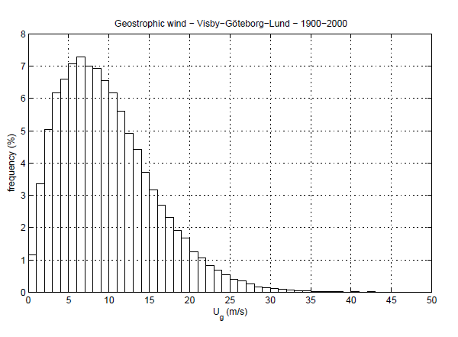
Lots of wind
Notes:
10 m/s is 22 miles per hour

Slide 7
Postmill stubbamölla
Introduced to Skåne in the 1200s
Very common in the 1600s

Slide 8
Parts of a post mill
Entire mill is mounted on a post or (stubbe)
Wings are turned into the wind by rotating the mill with the tail
Grain sacks were carried up the tail
Flour sacks were carried down the tail

Slide 9
Running a post mill
Power: wind velocity, sail area, angle to the wind
Grinding stone rpm: too fast – “burned flour”
Product quality: stone gap, feed rate
Notes:
The miller spent most of his time monitoring the product.

Slide 10
Post mill limitation
More production means more power
Requires bigger diameter wings
Which means higher axel
Which means bigger and heavier house
therefore harder to turn
Limited to one set of grinding stones
Customers for both flour and animal feed

Slide 11
Solution – Holländaren

Slide 12
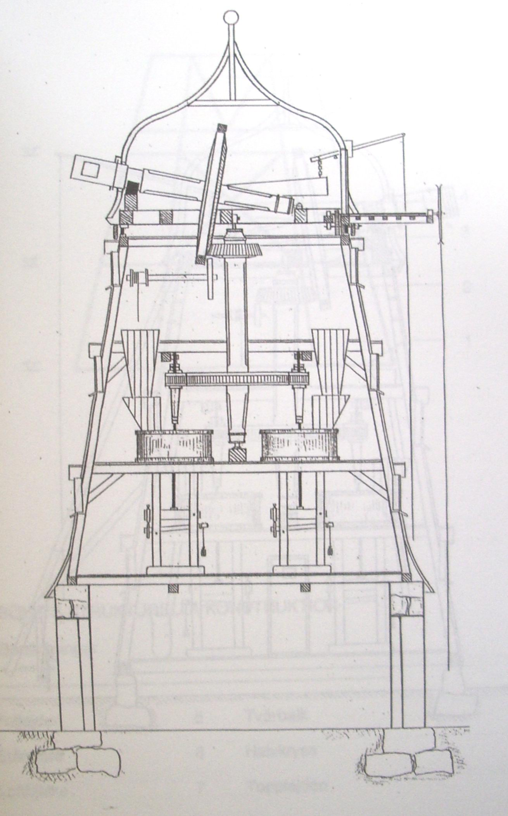
Only the top (hatten) rotates
The axle is higher so larger wings
Power 2 or more sets of grinding stones
More space to store grain sacks

Slide 13
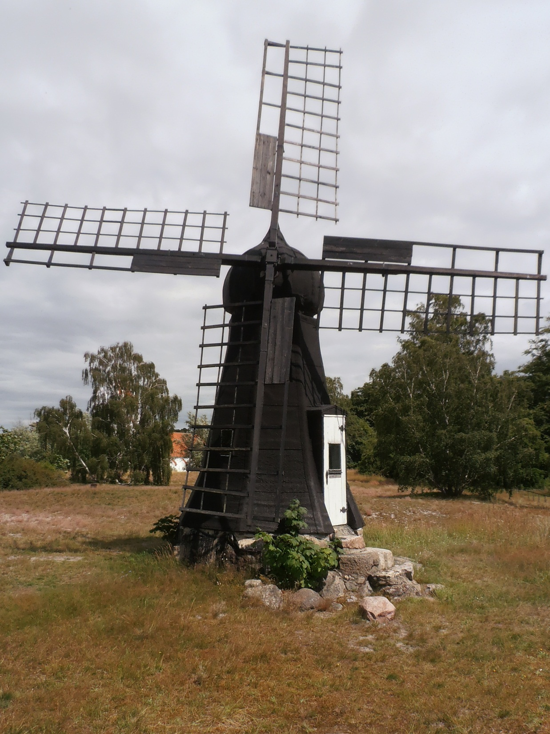
First holländare were small

Slide 14
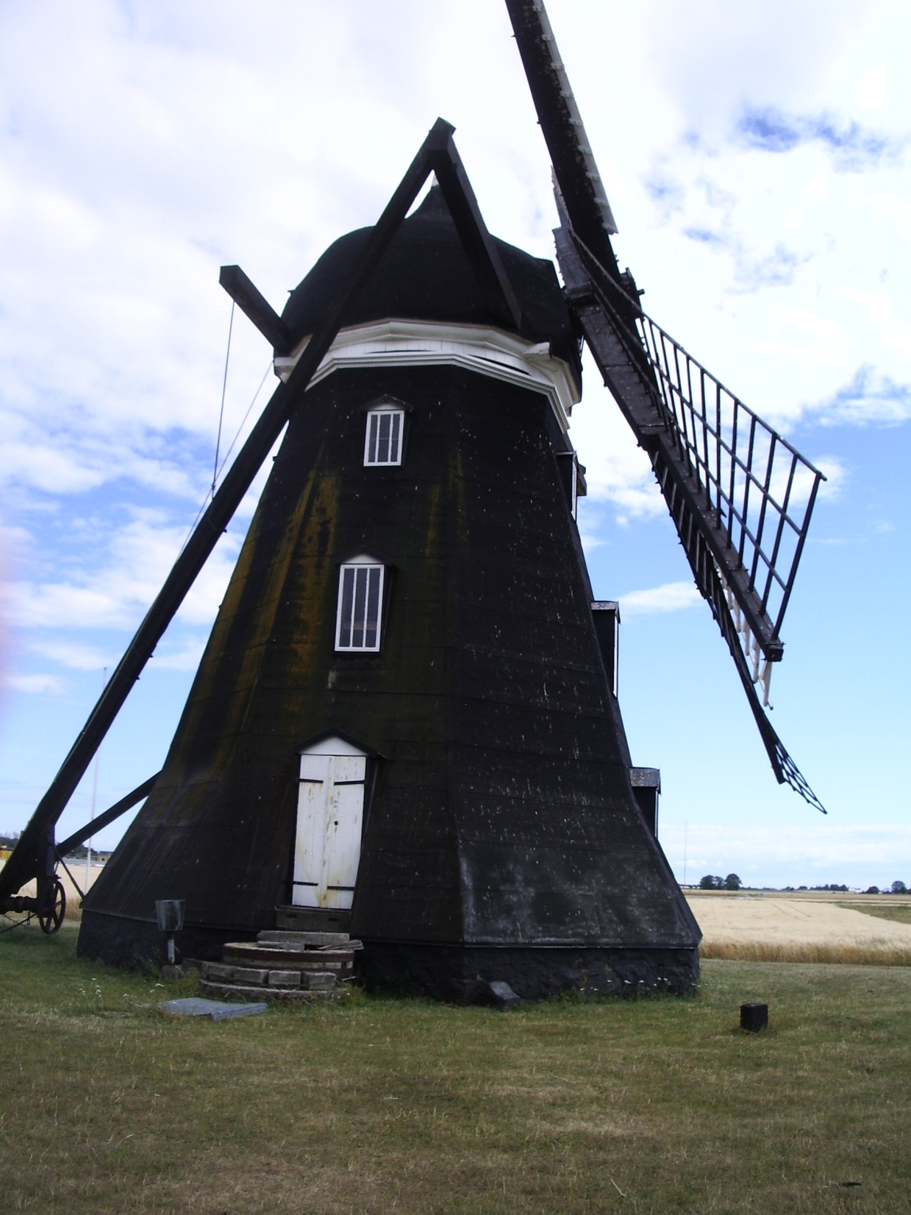
Next
Taller
But the wings came close to the ground
And grain sacks need to to be carried in by hand

Slide 15
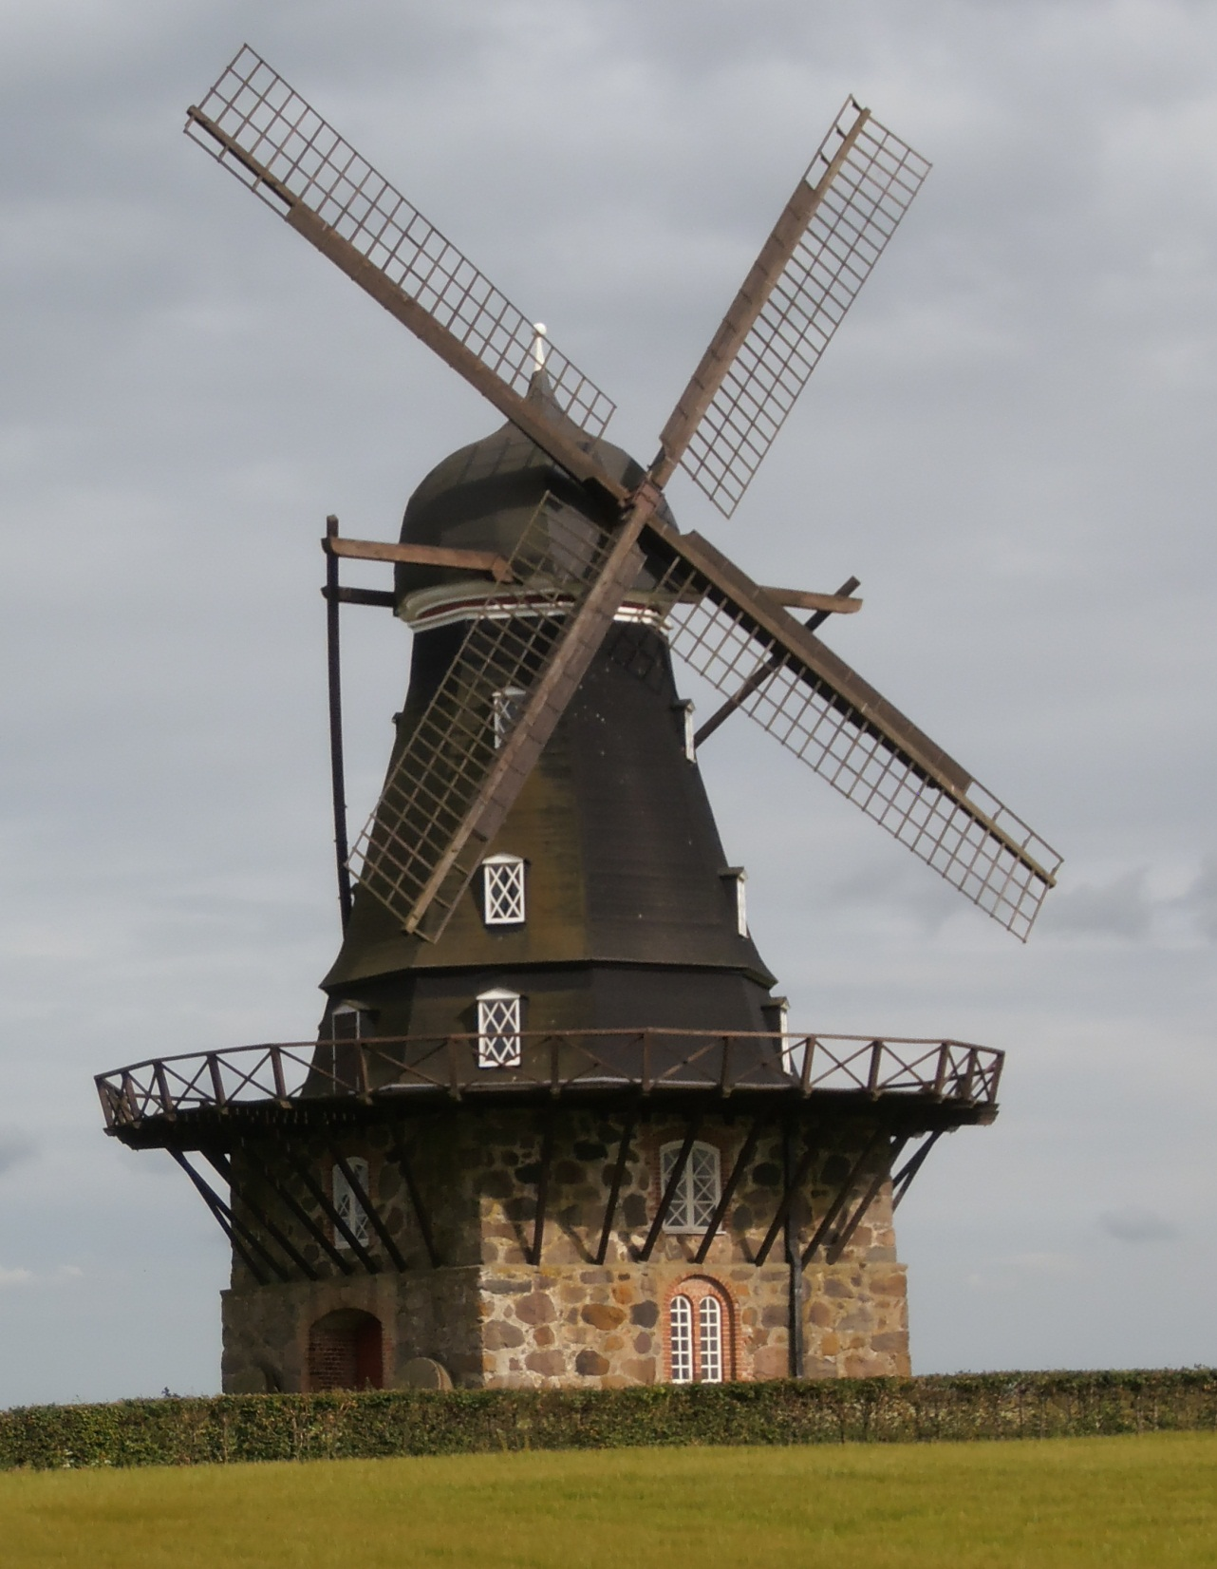
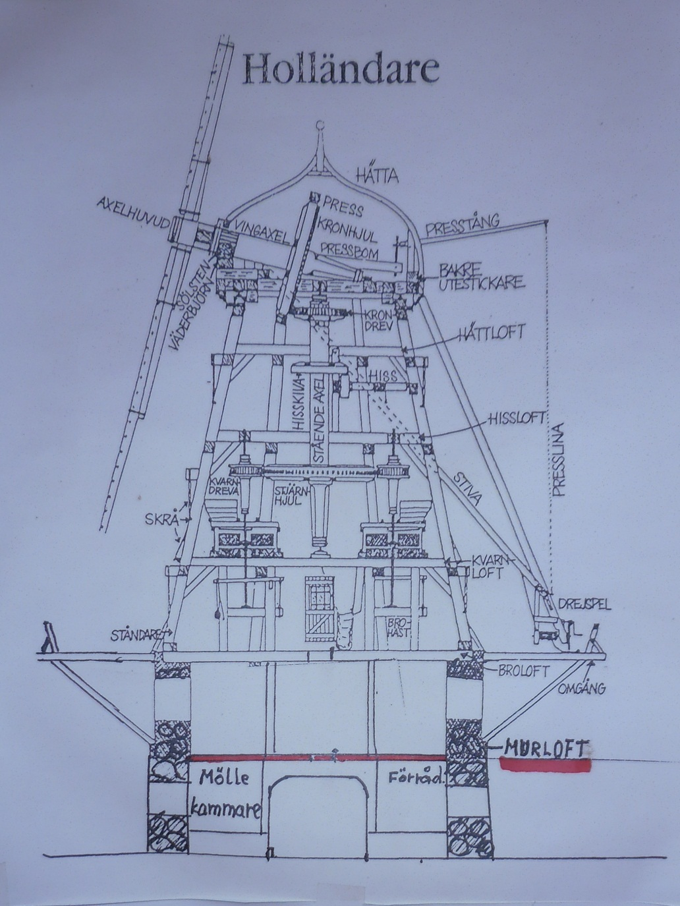

Slide 16
Elevator (hiss)

Slide 17
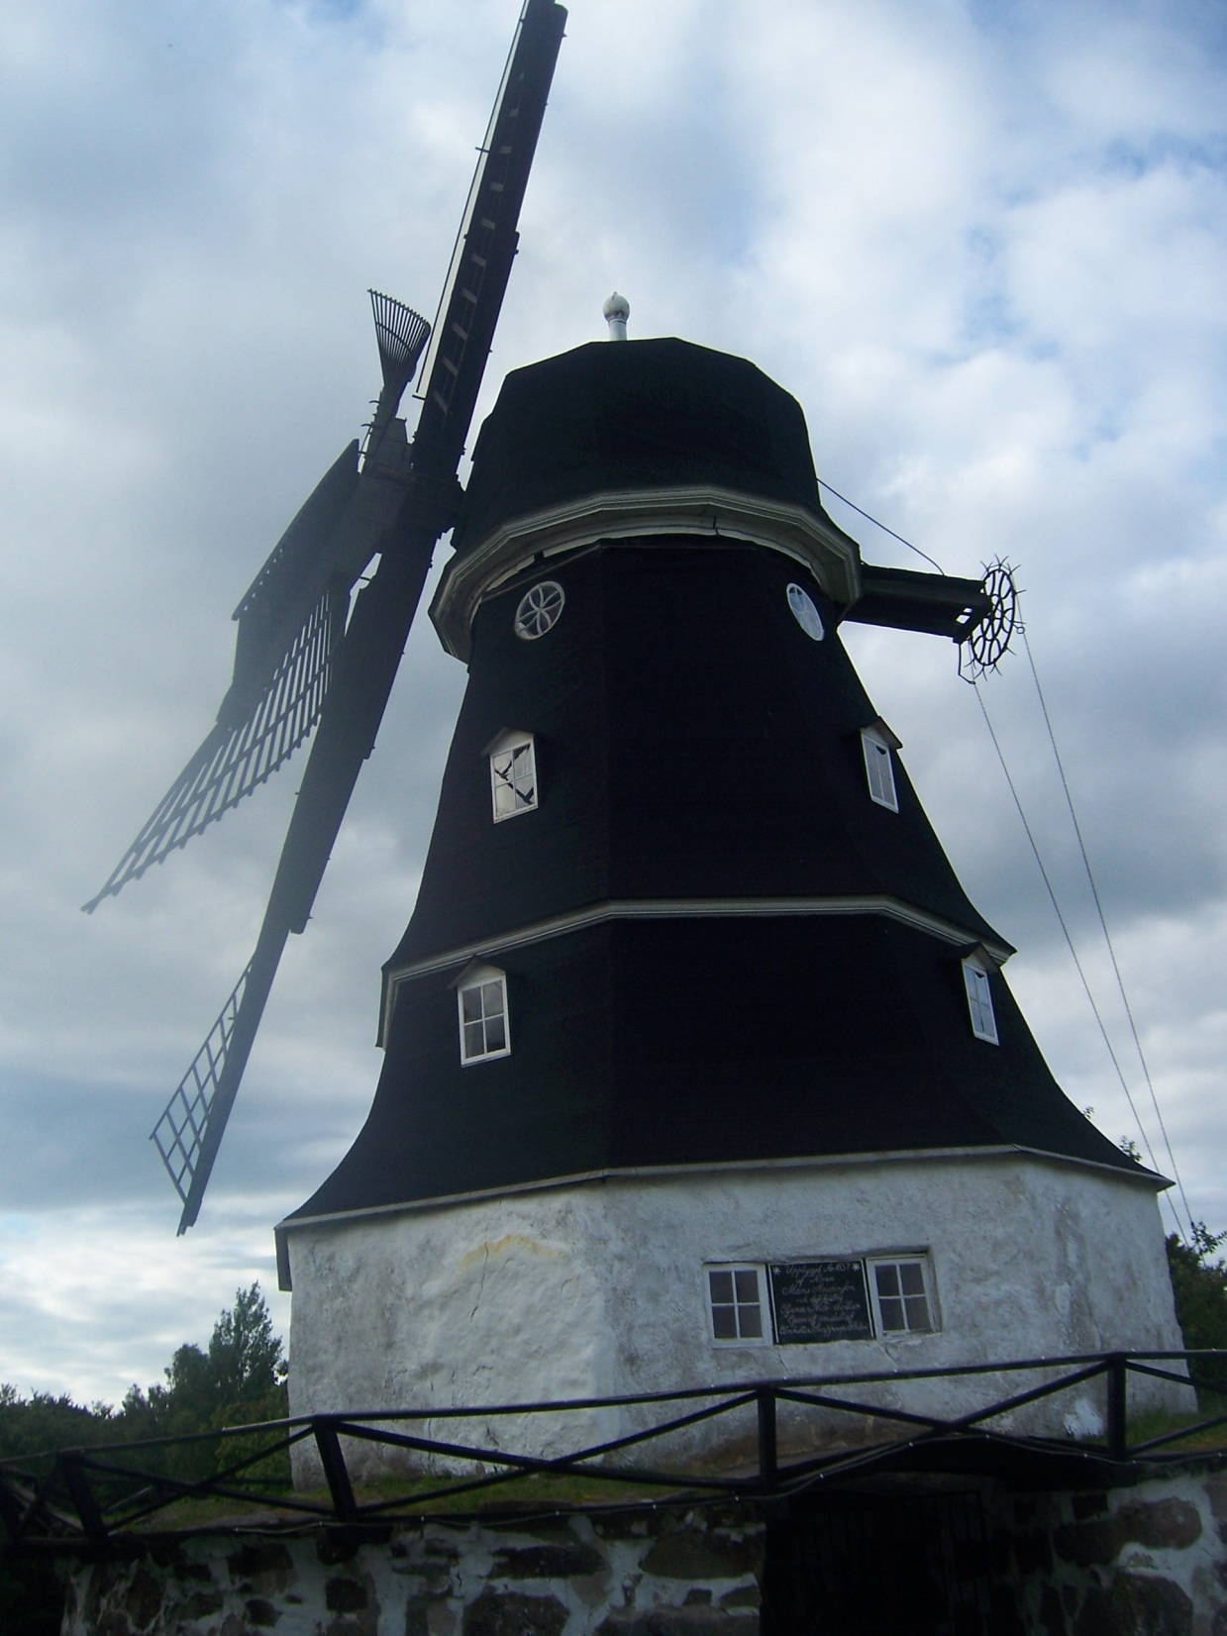
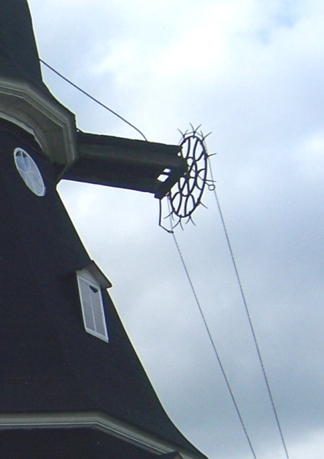

Slide 18
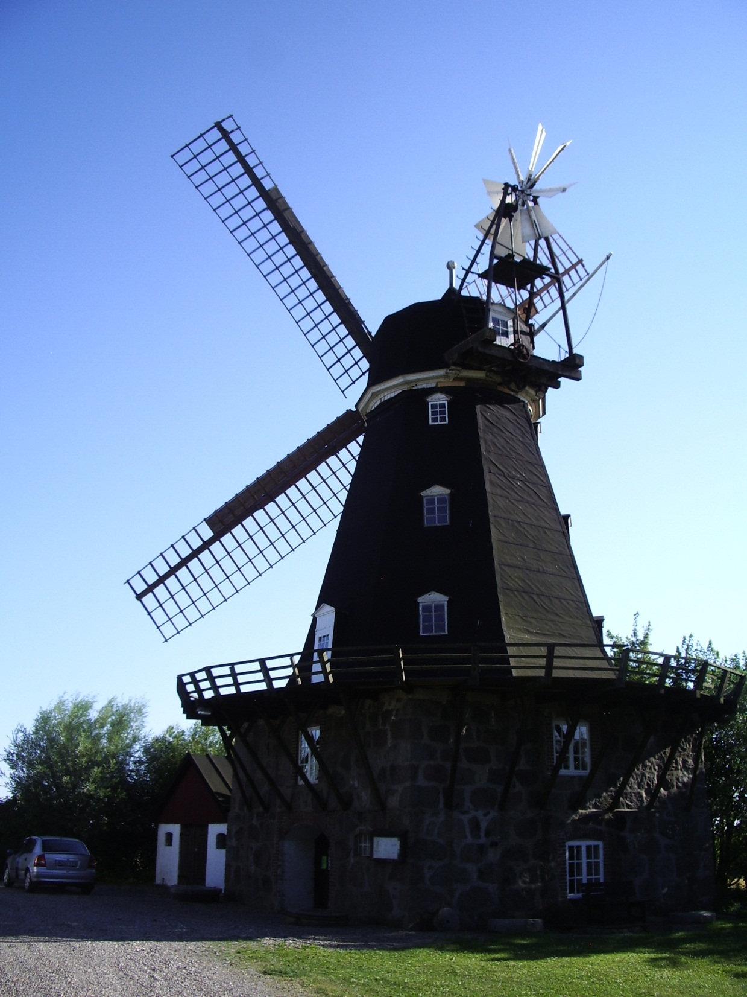
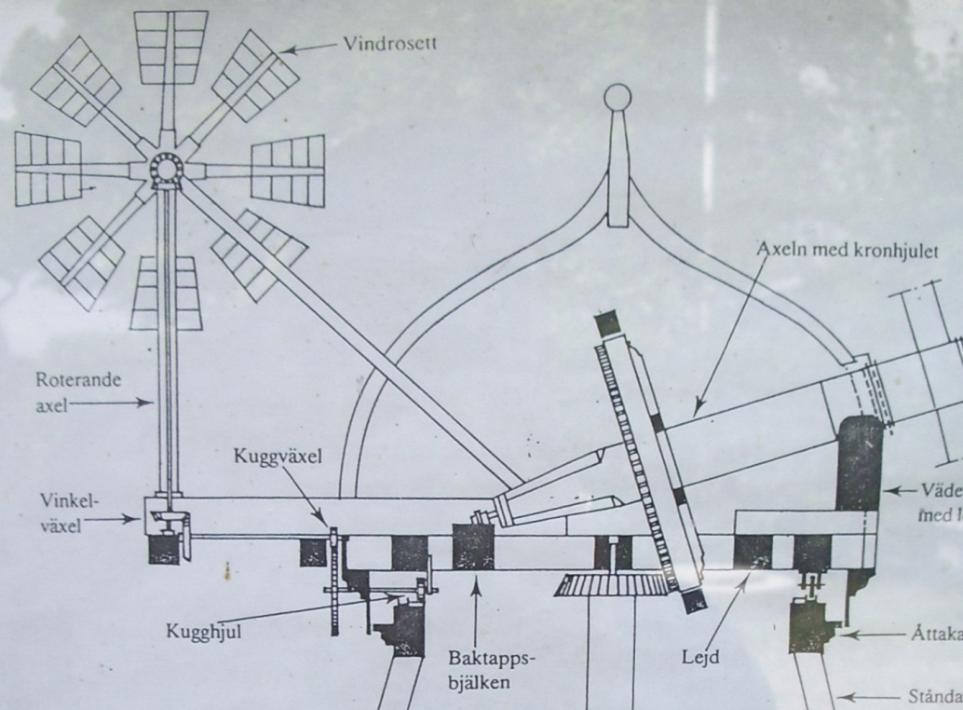

Slide 19
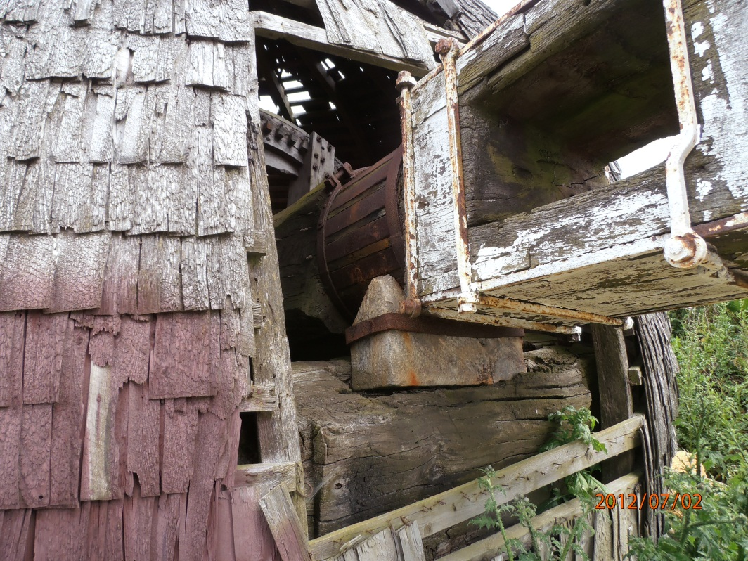
Steel was expensive

Slide 20
But became cheaper

Slide 21
Decline
Low cost electricity
Higher labor costs
Some mills were simply abandoned

Slide 22
Decline
Some mills let the wings “drop off” and just ran on electricity

Slide 23
Decline (cont’d)
Some have been tuned into storage sheds

Slide 24
Decline (cont’d)
Some have been converted to houses (bostadar, fritidhus)

Slide 25
Survivors
At the end of the 1800s there were about 1000 möllor in Skåne
Today there are less than 100 of which about 20 function (kan måla)
Övraby stopped in 1975 but is in good condition (gott skick)

Slide 26
Movie

