Slide 1
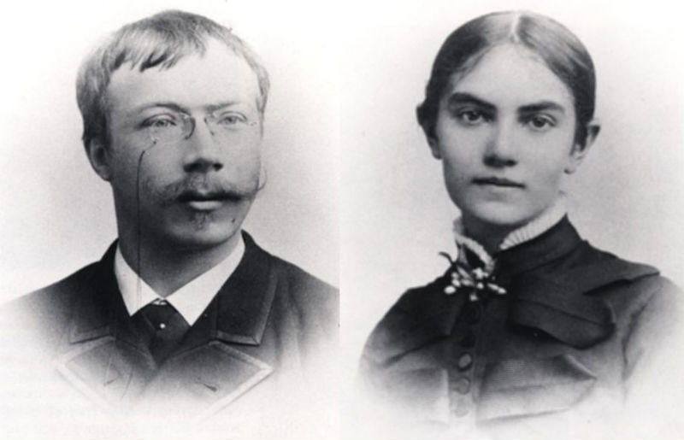
Carl and Karin (Bergöö) Carlsson
circa 1882-1883
Notes:
Carl and Karin (Bergöö) Carlsson
circa 1882-1883

Slide 2
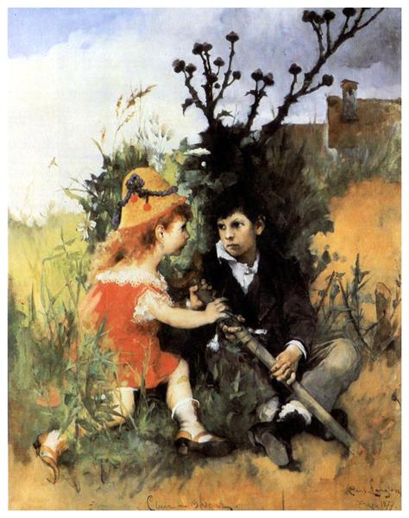
Clair Obscur
Carl Larsson - 1877
Notes:
Clair Obscur
Carl Larsson
Date: 1877; Sweden *
Style: Romanticism
Genre: genre painting

Slide 3
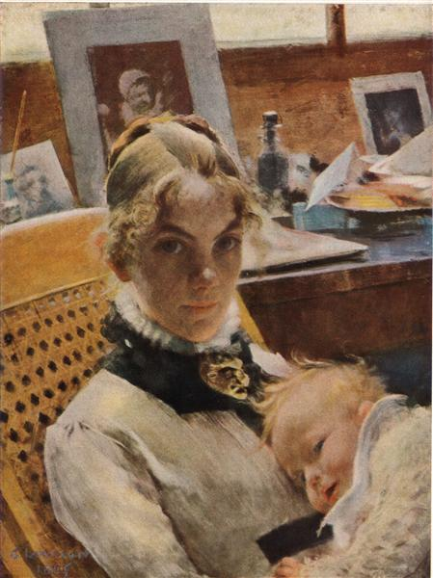
A Studio Idyll. The Artist’s Wife with Daughter Suzanne
Carl Larsson - 1884
Notes:
A Studio Idyll. The Artist’s Wife with Daughter Suzanne
Carl Larsson
Date: 1884; Sweden *
Style: Impressionism
Genre: portrait
Media: pastel, paper
Location: Private Collection

Slide 4
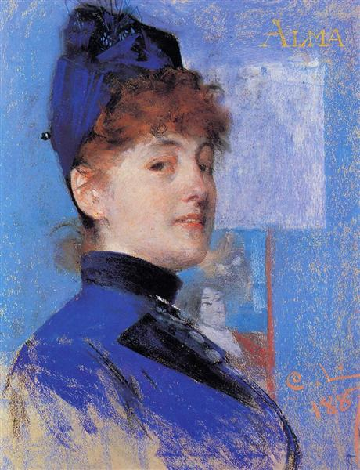
Portrait of Alma
Carl Larsson - 1887
Notes:
Portrait of Alma
Carl Larsson
Date: 1887; Sweden *
Style: Impressionism
Genre: portrait
Media: pastel, paper
Location: Private Collection

Slide 5
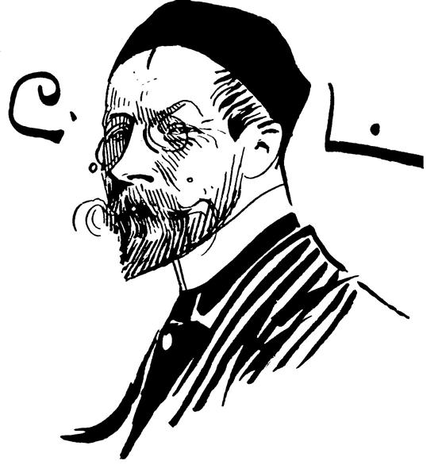
Self-portrait
Carl Larsson - 1891
Notes:
Self-portrait
Carl Larsson
Date: 1891; Sweden *
Style: Art Nouveau (Modern)
Genre: self-portrait

Slide 6
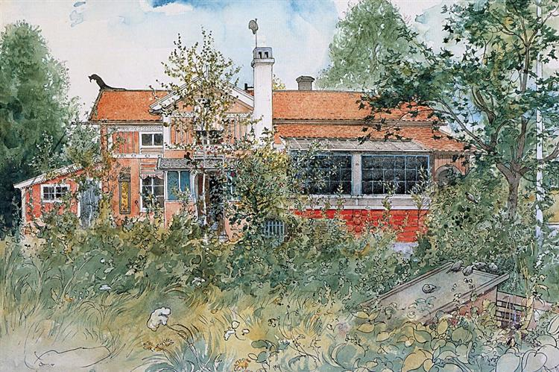
The Cottage
Carl Larsson - 1895
Notes:
The Cottage
Carl Larsson
Date: c.1895; Sweden *
Style: Art Nouveau (Modern)
Series: A Home
Genre: landscape
Media: watercolor, paper
Dimensions: 32 x 43 cm
Location: Nationalmuseum, Stockholm, Sweden

Slide 7
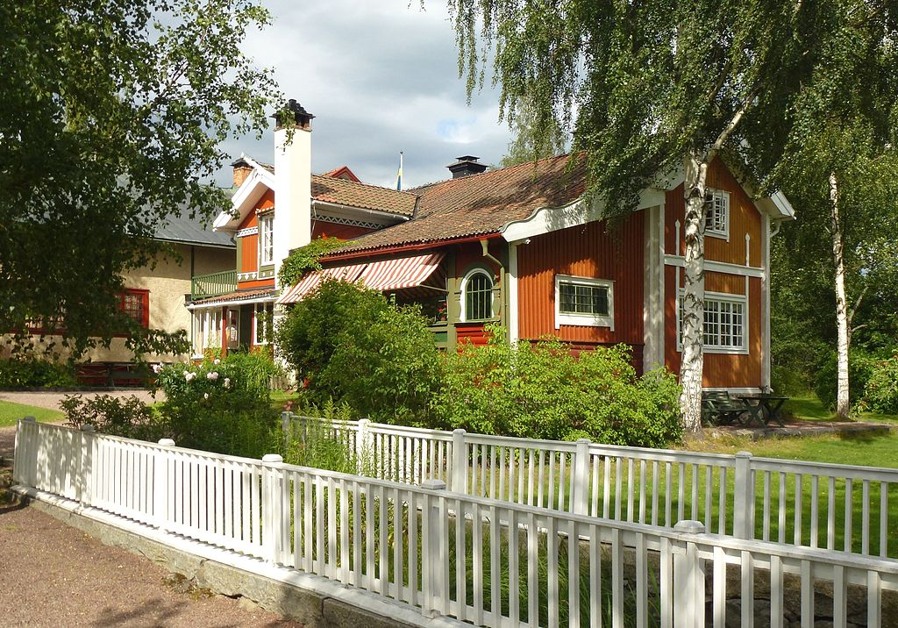
Carl Larsson's house, Lilla Hyttnäs in Sundborn, a museum today
Notes:
The Cottage
Carl Larsson
Date: c.1895; Sweden *
Style: Art Nouveau (Modern)
Series: A Home
Genre: landscape
Media: watercolor, paper
Dimensions: 32 x 43 cm
Location: Nationalmuseum, Stockholm, Sweden

Slide 8
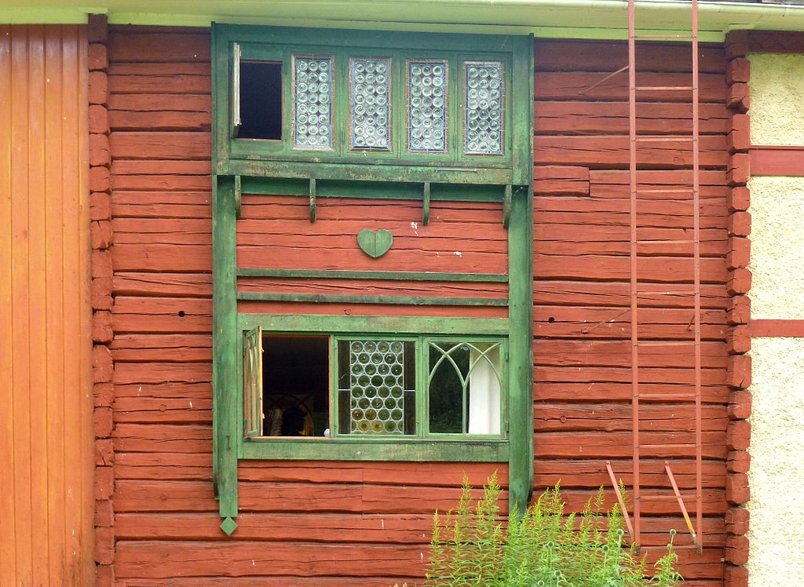
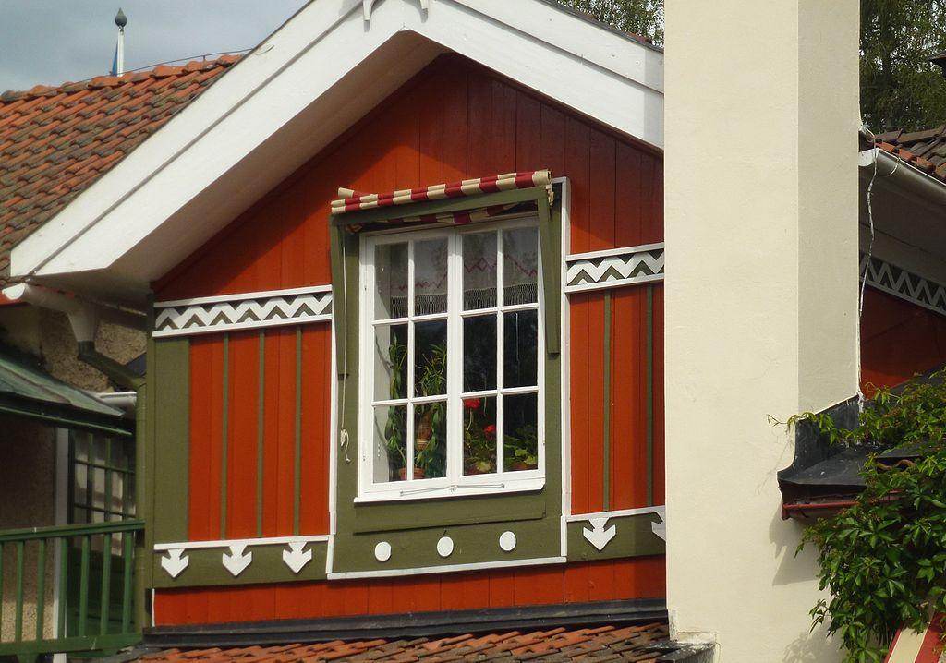
Carl Larsson's house, Lilla Hyttnäs in Sundborn, details of the cottage
Notes:
The Cottage
Carl Larsson
Date: c.1895; Sweden *
Style: Art Nouveau (Modern)
Series: A Home
Genre: landscape
Media: watercolor, paper
Dimensions: 32 x 43 cm
Location: Nationalmuseum, Stockholm, Sweden

Slide 9
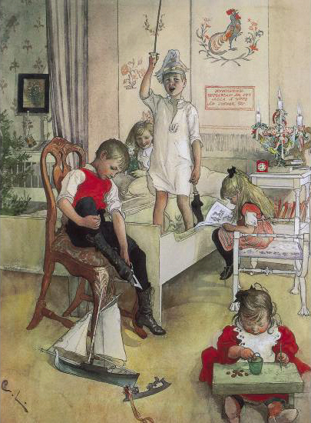
Christmas Morning
Carl Larsson - 1894
Notes:
Christmas Morning
Carl Larsson
Date: 1894; Sweden *
Style: Art Nouveau (Modern)
Genre: genre painting

Slide 10
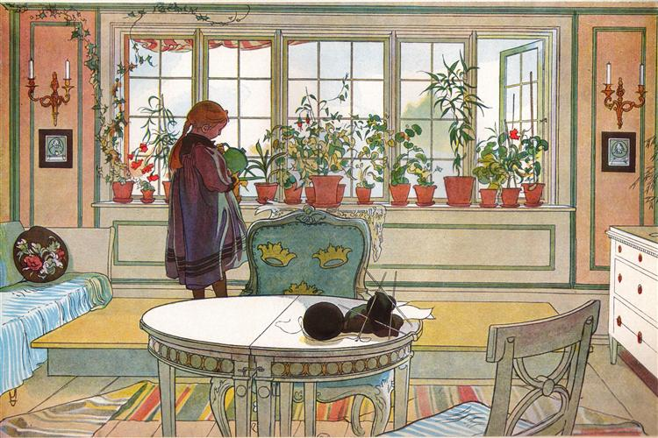
Flowers on the Windowsill
Carl Larsson - 1894
Notes:
Flowers on the windowsill
Carl Larsson
Date: 1894; Sweden *
Style: Art Nouveau (Modern)
Genre: interior
Media: watercolor, paper
Location: Nationalmuseum, Stockholm, Sweden

Slide 11
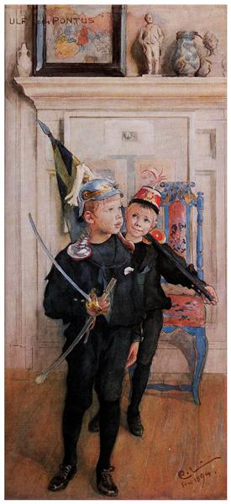
Ulf and Pontus
Carl Larsson - 1894
Notes:
Ulf and Pontus
Carl Larsson
Date: 1894; Sweden *
Style: Art Nouveau (Modern)
Genre: portrait
Media: watercolor, paper

Slide 12
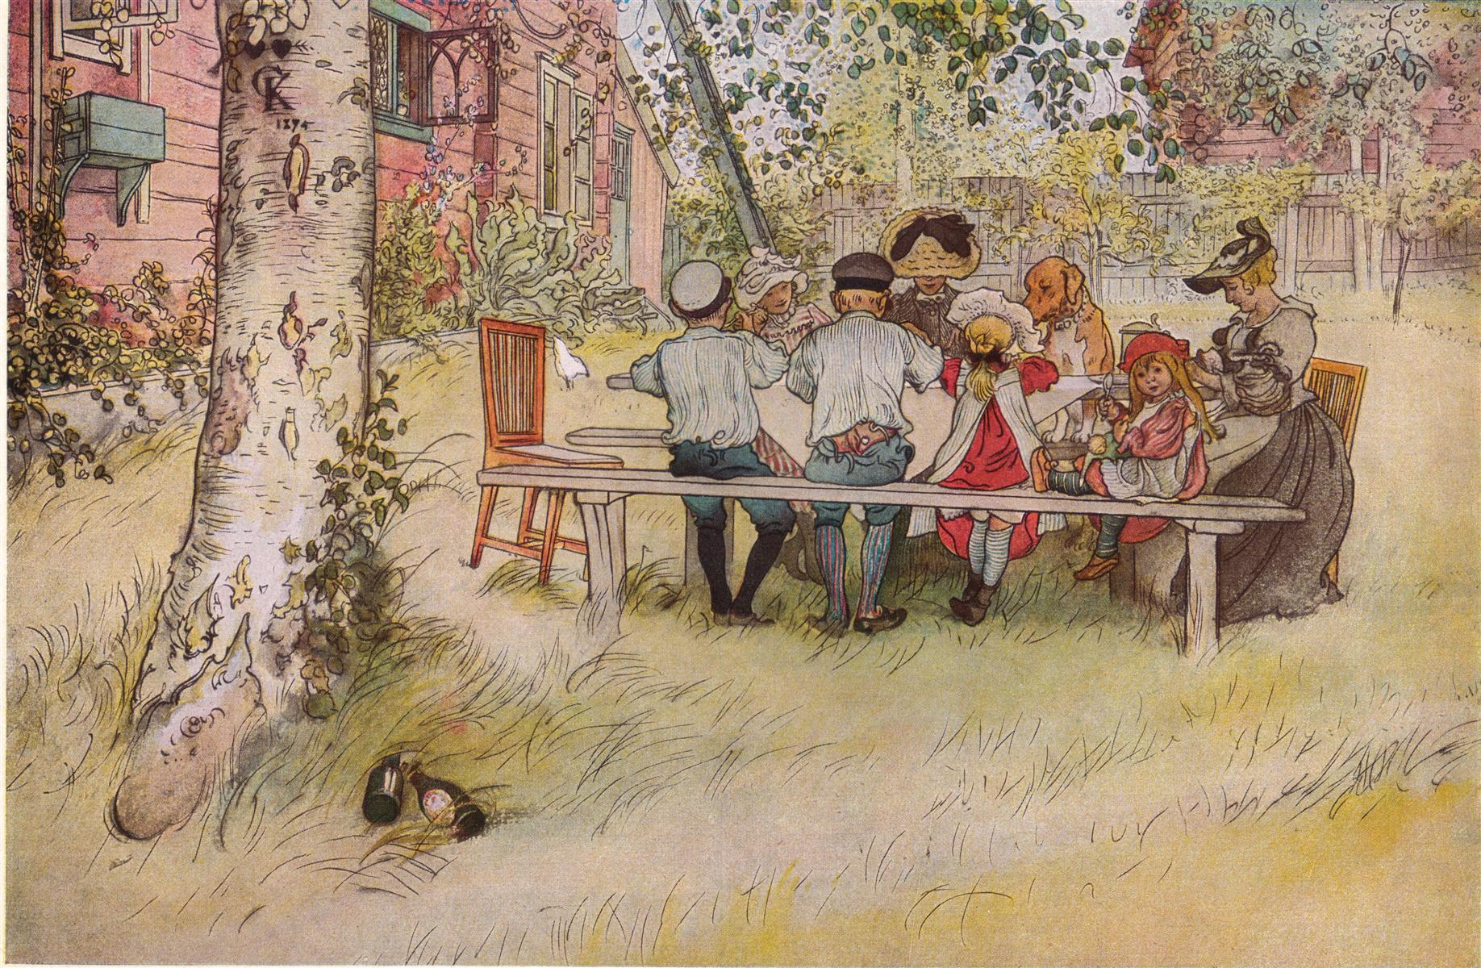
Breakfast under the Big Birch
Carl Larsson - 1895
Notes:
Breakfast under the Big Birch
Carl Larsson
Date: c.1895; Sweden *
Style: Art Nouveau (Modern)
Series: A Home
Genre: genre painting
Media: watercolor, paper
Dimensions: 32 x 43 cm
Location: Nationalmuseum, Stockholm, Sweden

Slide 13
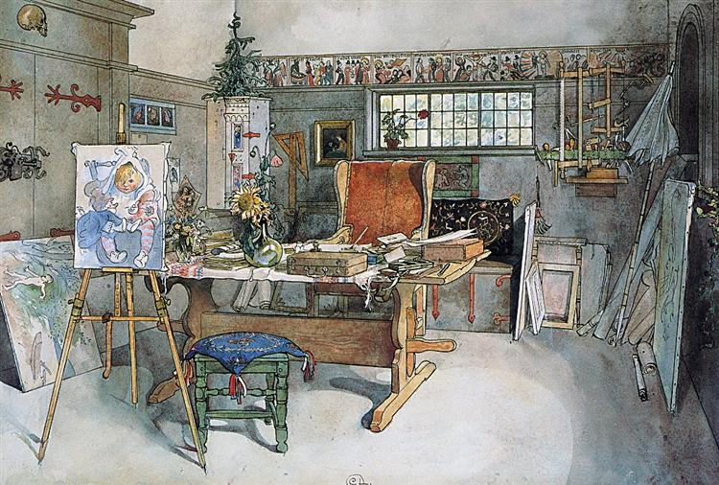
The Studio
Carl Larsson - 1895
Notes:
The Studio
Carl Larsson
Date: 1895; Sweden *
Style: Art Nouveau (Modern)
Genre: interior
Media: watercolor, paper

Slide 14
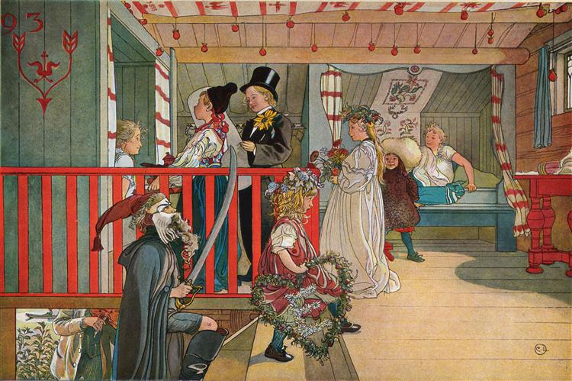
A Day of Celebration
Carl Larsson - 1895
Notes:
A Day of Celebration
Carl Larsson
Date: c.1895; Sweden *
Style: Art Nouveau (Modern)
Series: A Home
Genre: genre painting
Media: watercolor, paper
Dimensions: 32 x 43 cm
Location: Nationalmuseum, Stockholm, Sweden

Slide 15
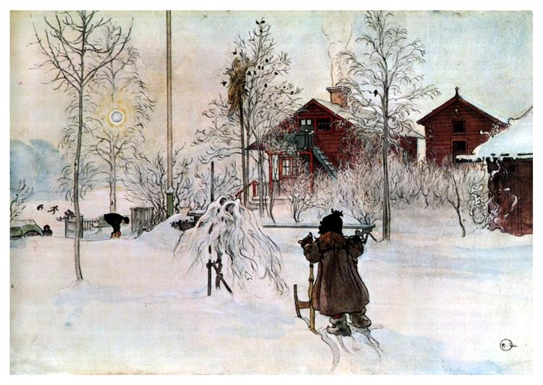
The Yard and Washhouse
Carl Larsson - 1895
Notes:
The Yard and Washhouse
Carl Larsson
Date: c.1895; Sweden *
Style: Art Nouveau (Modern)
Series: A Home
Genre: genre painting
Media: watercolor, paper
Dimensions: 32 x 43 cm
Location: Nationalmuseum, Stockholm, Sweden

Slide 16
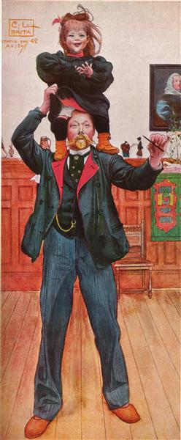
Brita and me
Carl Larsson - 1895
Notes:
Brita and me
Carl Larsson
Style: Art Nouveau (Modern)
Genre: self-portrait
Media: watercolor, paper
Location: Nationalmuseum, Stockholm, Sweden

Slide 17
The Studio
Carl Larsson - 1895
Notes:
The Studio
Carl Larsson
Date: 1895; Sweden *
Style: Art Nouveau (Modern)
Genre: interior
Media: watercolor, paper

Slide 18
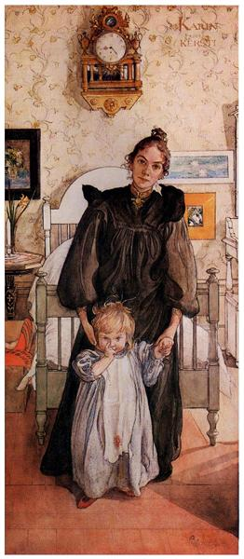
Karin and Kersti
Carl Larsson - 1898
Notes:
Karin and Kersti
Carl Larsson
Date: 1898; Sweden *
Style: Art Nouveau (Modern)
Genre: portrait
Media: watercolor, paper

Slide 19
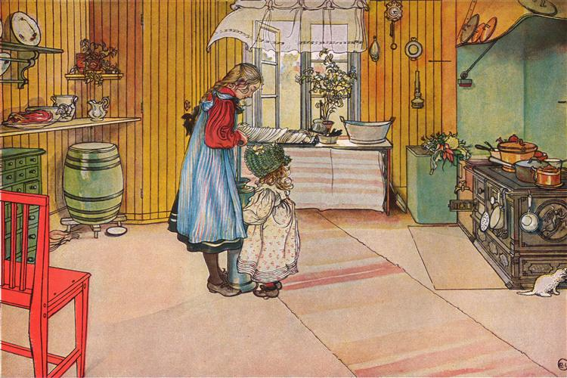
The Kitchen
Carl Larsson - 1898
Notes:
The Kitchen
Carl Larsson
Date: c.1898; Sweden *
Style: Art Nouveau (Modern)
Genre: genre painting
Media: watercolor, paper
Location: Nationalmuseum, Stockholm, Sweden

Slide 20
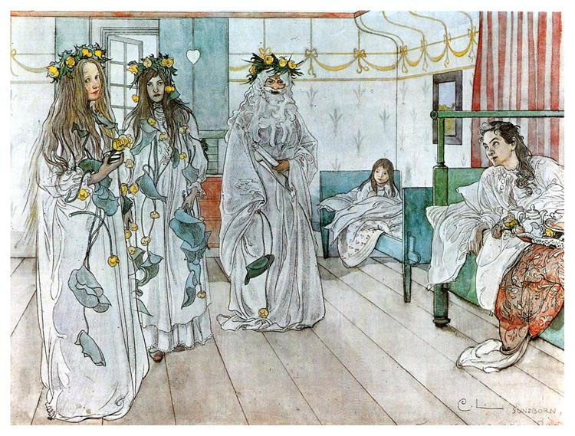
Karin’s Name Day
Carl Larsson - 1899
Notes:
Karin’s Name Day
Carl Larsson
Date: 1899; Sweden *
Style: Art Nouveau (Modern)
Genre: genre painting
Media: watercolor, paper

Slide 21
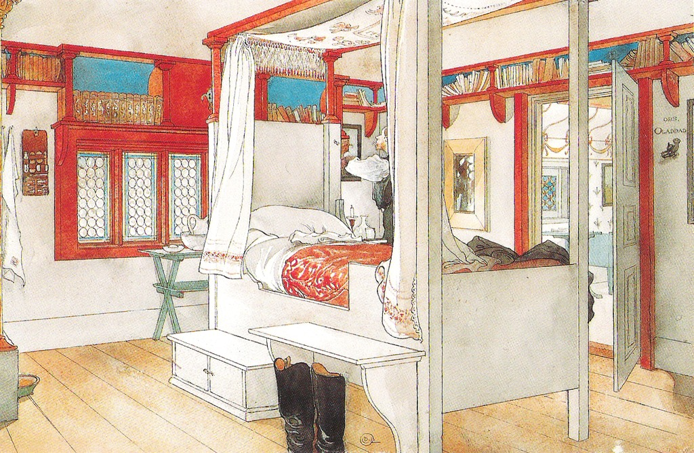
Carl Larsson’s bed
Carl Larsson - 1899
Notes:
Carl Larsson’s bed
Carl Larsson
Date: 1899; Sweden *
Style: Art Nouveau (Modern)
Genre: genre painting
Media: watercolor, paper
Location: Nationalmuseum, Stockholm, Sweden

Slide 22
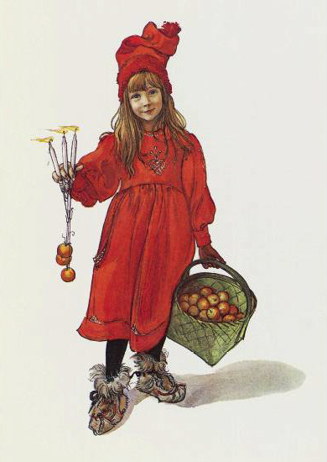
Brita as Iduna
Carl Larsson - 1901
Notes:
Brita as Iduna
Carl Larsson
Date: 1901; Sweden *
Style: Art Nouveau (Modern)
Genre: portrait

Slide 23
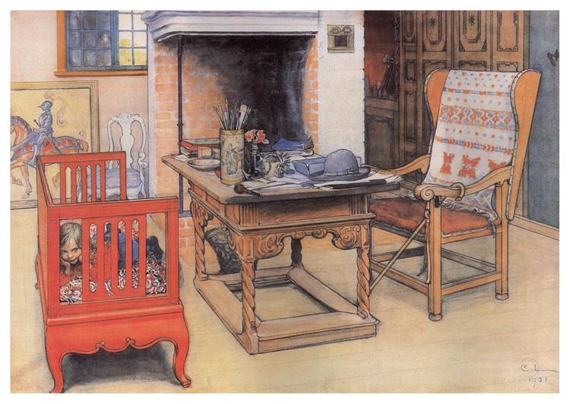
Peek-a-Boo
Carl Larsson - 1901
Notes:
Peek-a-Boo
Carl Larsson
Date: 1901; Sweden *
Style: Art Nouveau (Modern)
Genre: interior
Media: watercolor, paper

Slide 24
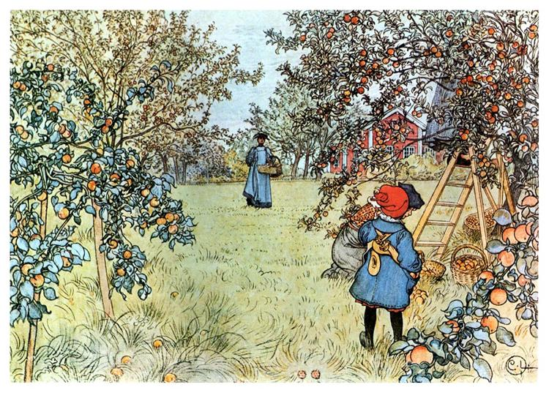
The Apple Harvest
Carl Larsson - 1903
Notes:
The Apple Harvest
Carl Larsson
Date: 1903; Sweden *
Style: Art Nouveau (Modern)
Genre: genre painting
Media: watercolor, paper
Location: Private Collection

Slide 25
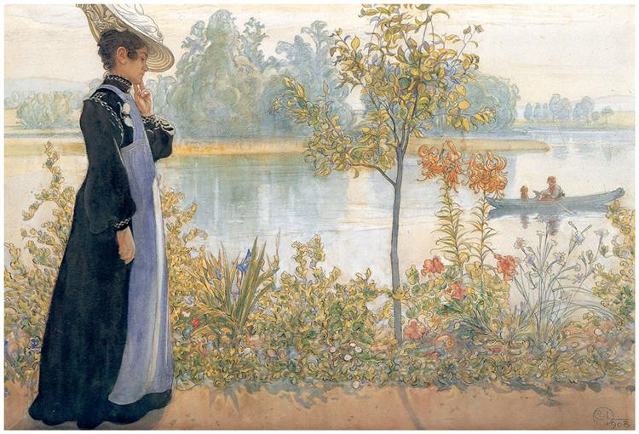
Karin on the Shore
Carl Larsson – circa 1908
Notes:
Karin on the Shore
Carl Larsson
Date: circa 1908; Sweden
Style: Art Nouveau (Modern)
Genre: genre painting

Slide 26
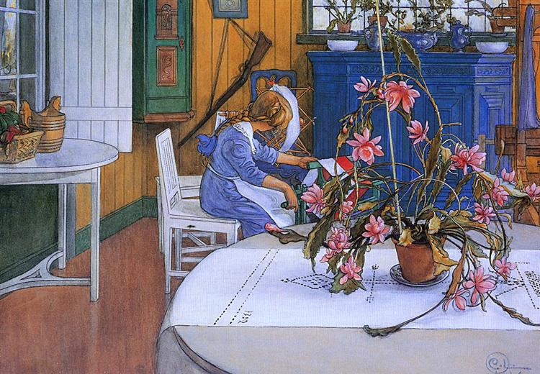
Interior with a Cactus
Carl Larsson - 1914
Notes:
Interior With a Cactus
Carl Larsson
Date: 1914; Sweden *
Style: Art Nouveau (Modern)
Genre: interior
Media: watercolor, paper

Slide 27
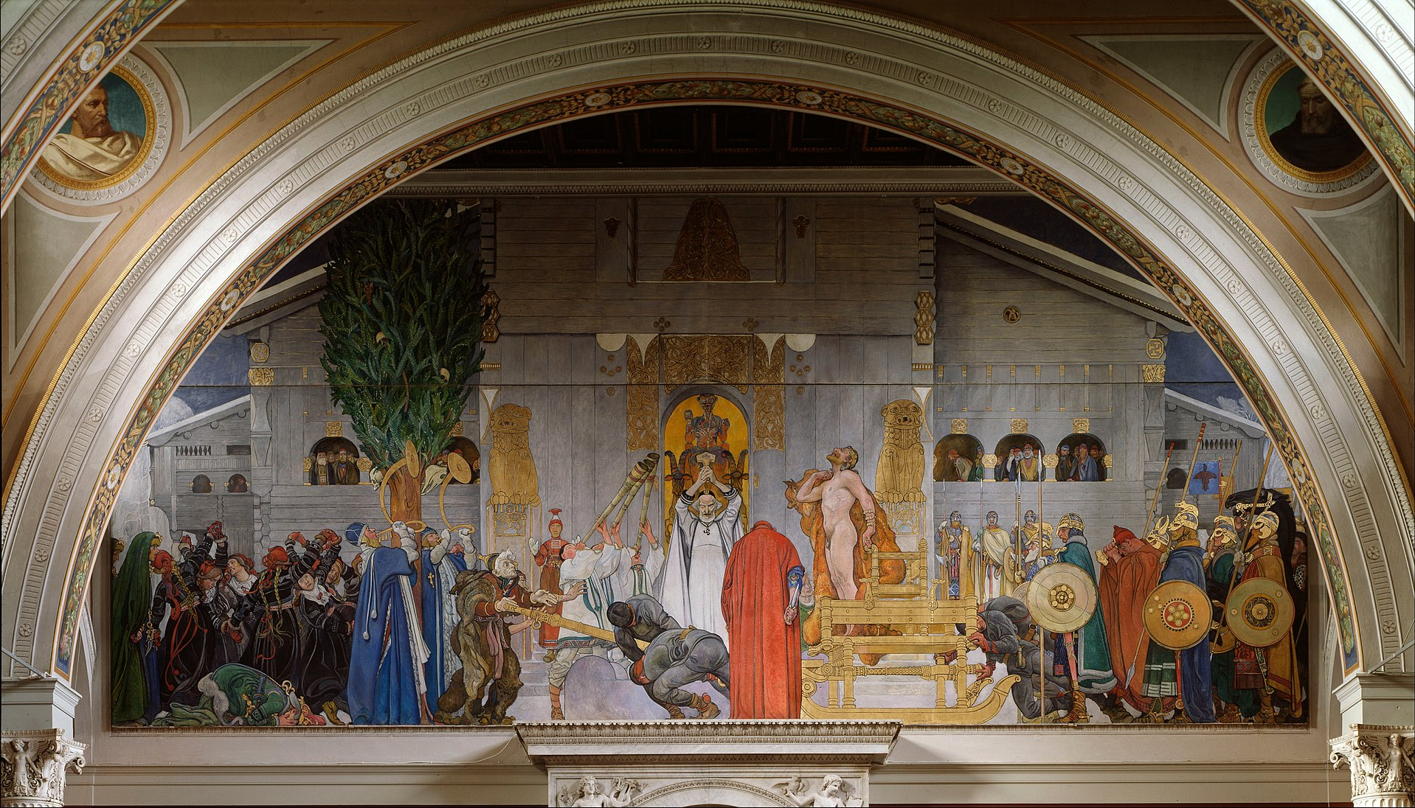
Midvinterblot
Carl Larsson - 1915
Notes:
Midvinterblot
Carl Larsson
Date: c.1915; Sweden *
Style: Art Nouveau (Modern)
Series: A Home
Genre: genre painting
Media: Oil on canvas
Dimensions: 640 x 1360 cm
Location: Nationalmuseum, Stockholm, Sweden

