Slide 1
A Swedish prince visits Sacramento!
Prince Vilhelm, second son of
Gustav V, plants a couple of trees
in the Fall of 1927

Slide 2
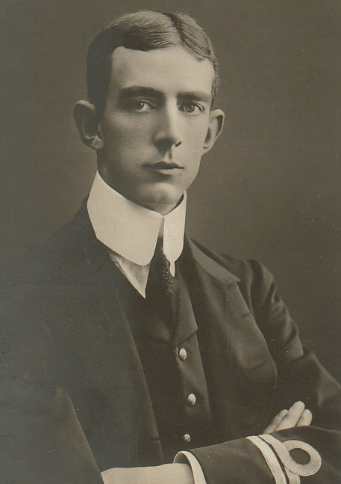
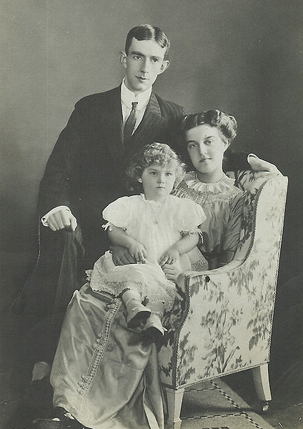
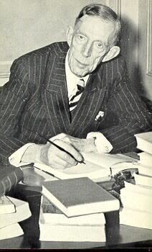
Prince Vilhelm Prince Vilhelm, Princess Prince Vilhelm circa 1909 Maria and Prince Lennart circa early 1960s circa 1911

Slide 3
Prince Vilhelm and members of the Zion Lutheran Church in November 1927 – Planting a tree in honor of American soldiers and sailors of Swedish descent who lost their lives in World War I.

Slide 4
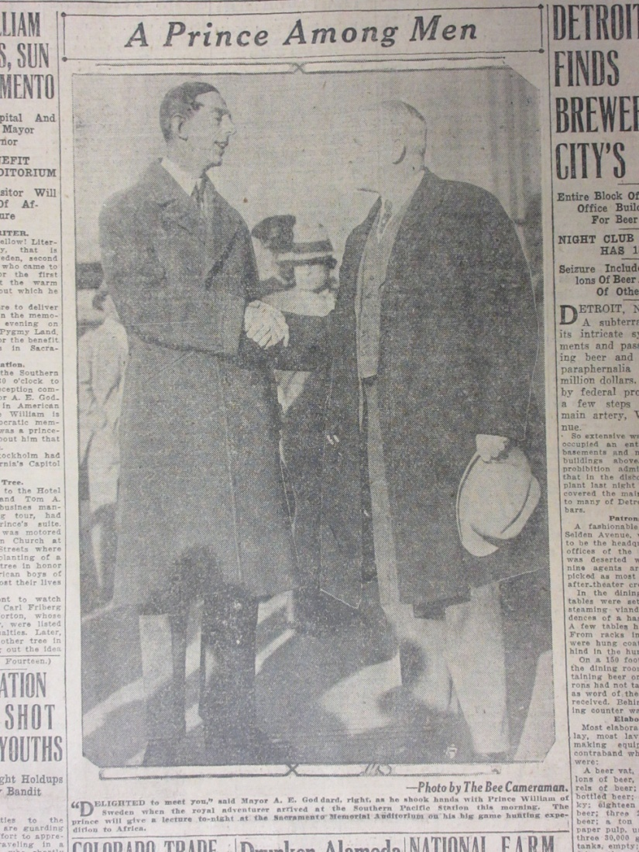
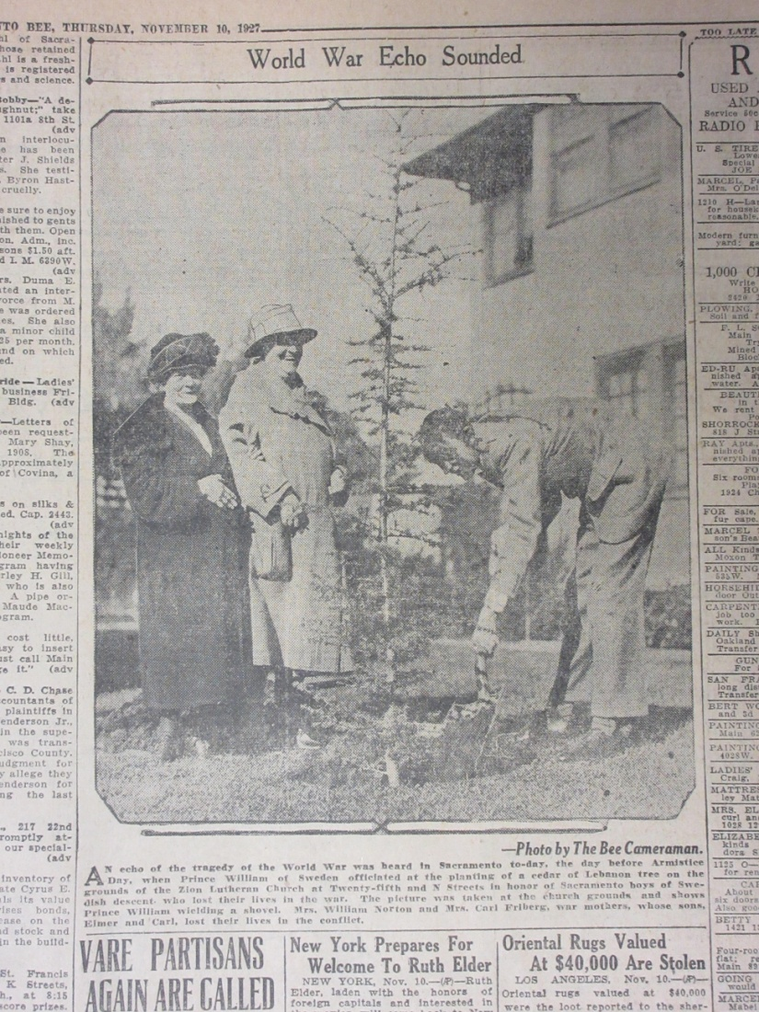
Pictures and article from the Sacramento Bee, November 10, 1927

Slide 5
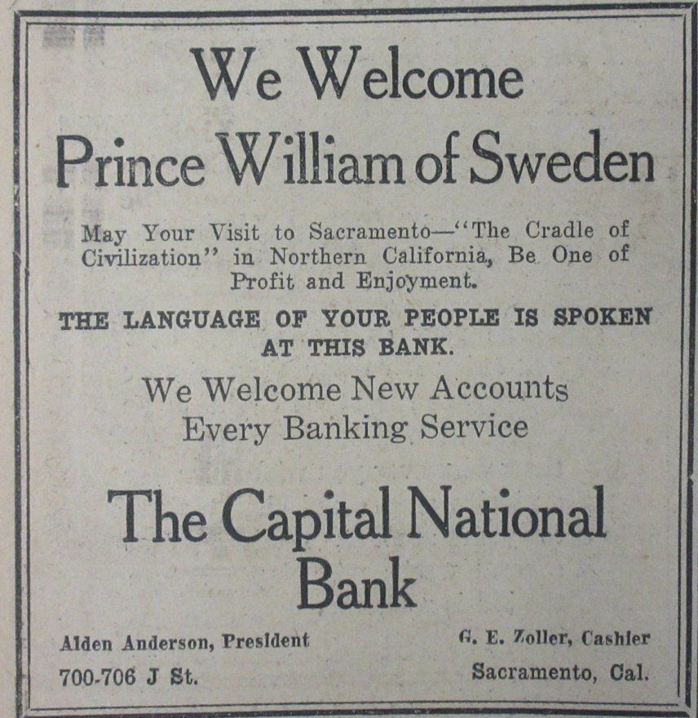
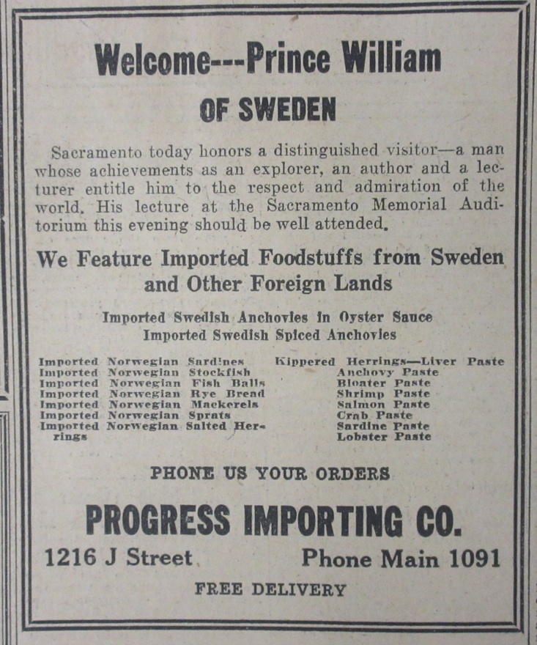
Leveraging the presence of public figures never changes. A variety of advertisements in the Sacramento Bee November 10, 1927 edition. Neither Capital National Bank nor Progress Importing are in business any more.

Slide 6
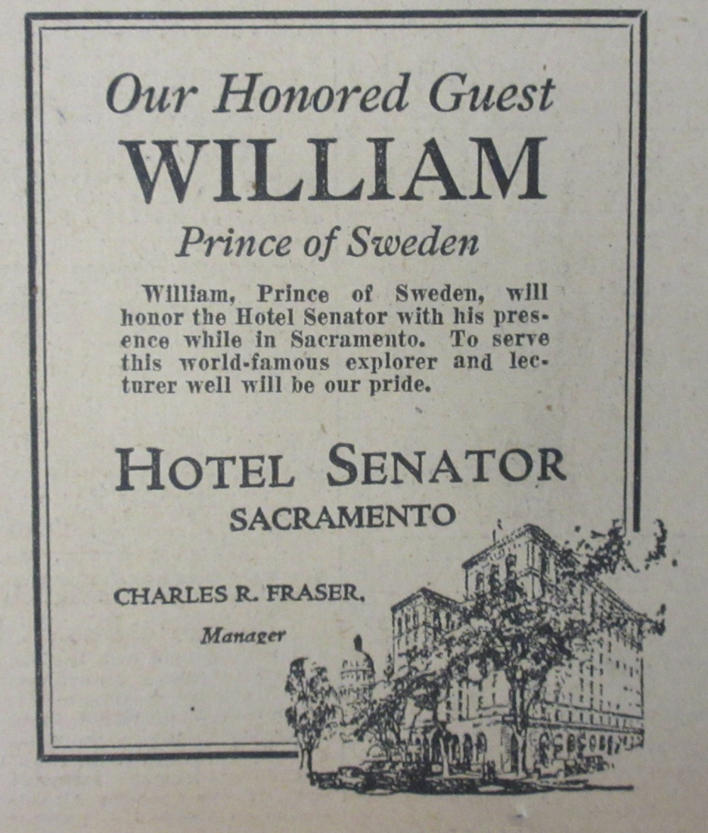
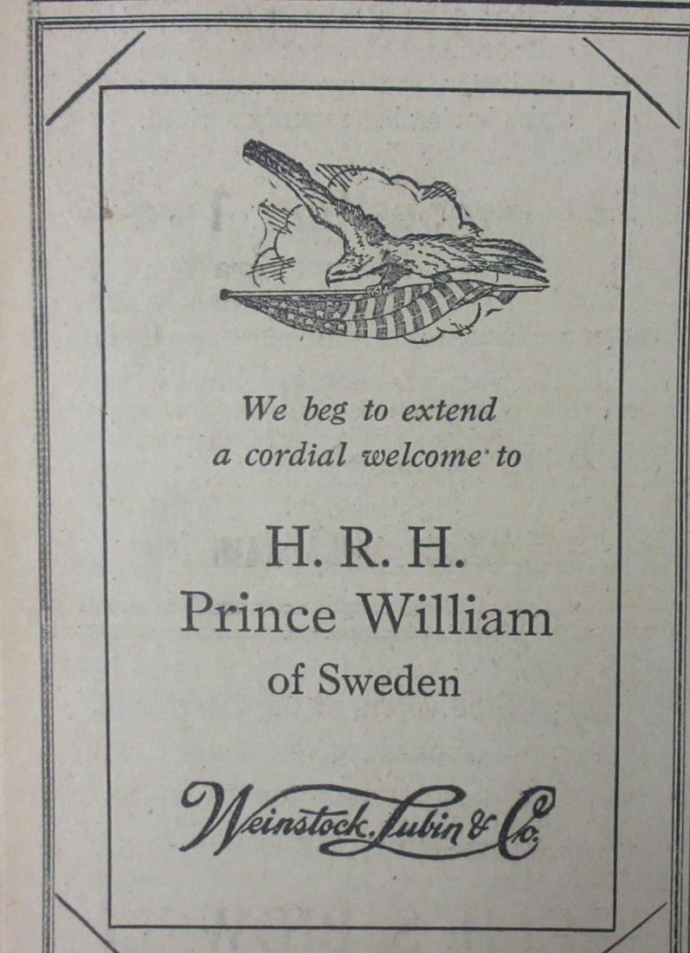
More advertisements of establishments that are now just memories: Hotel Senator and Weinstocks

Slide 7
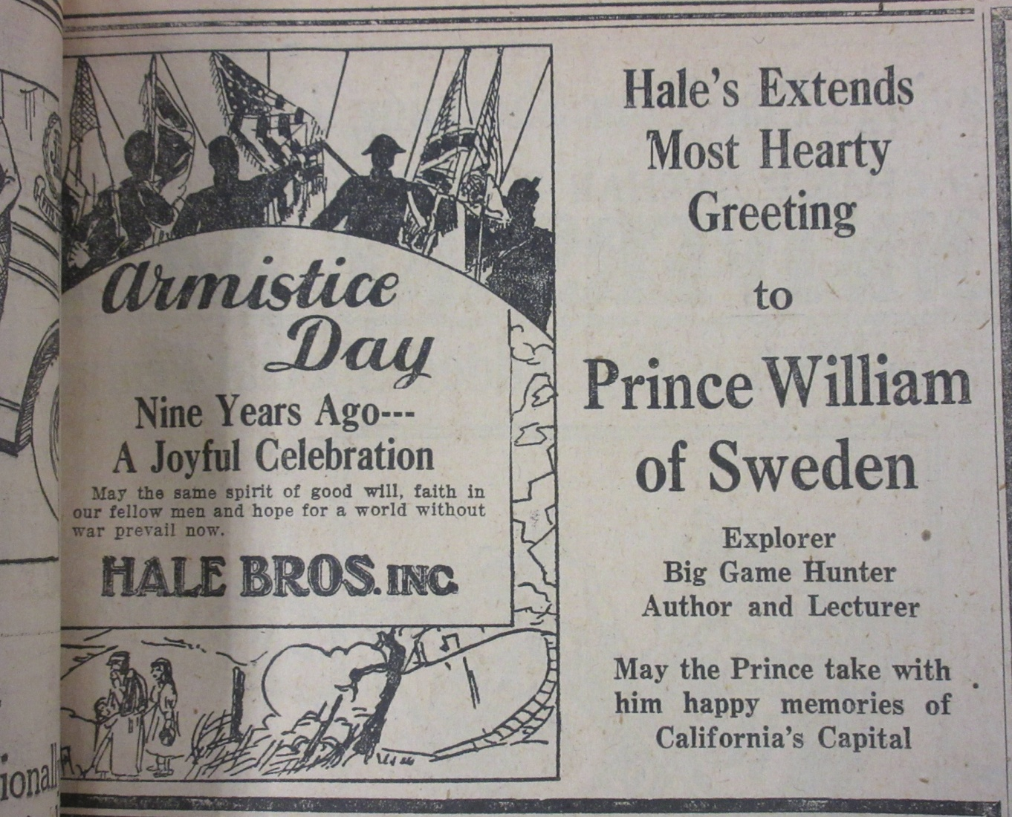
This advertisement by Hale Bros. (also not longer in business) even provided a short biography of the prince’s avocations.

Slide 8
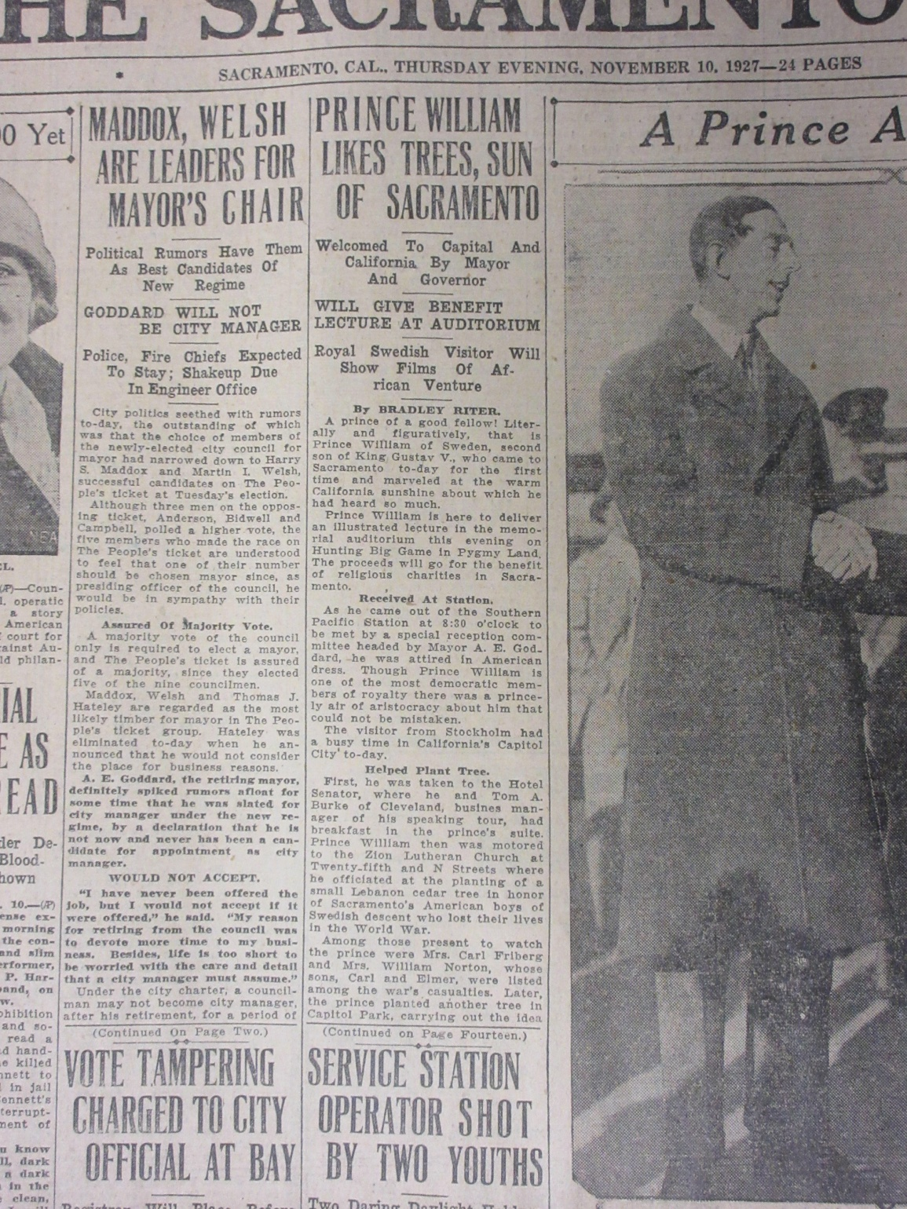

Slide 9
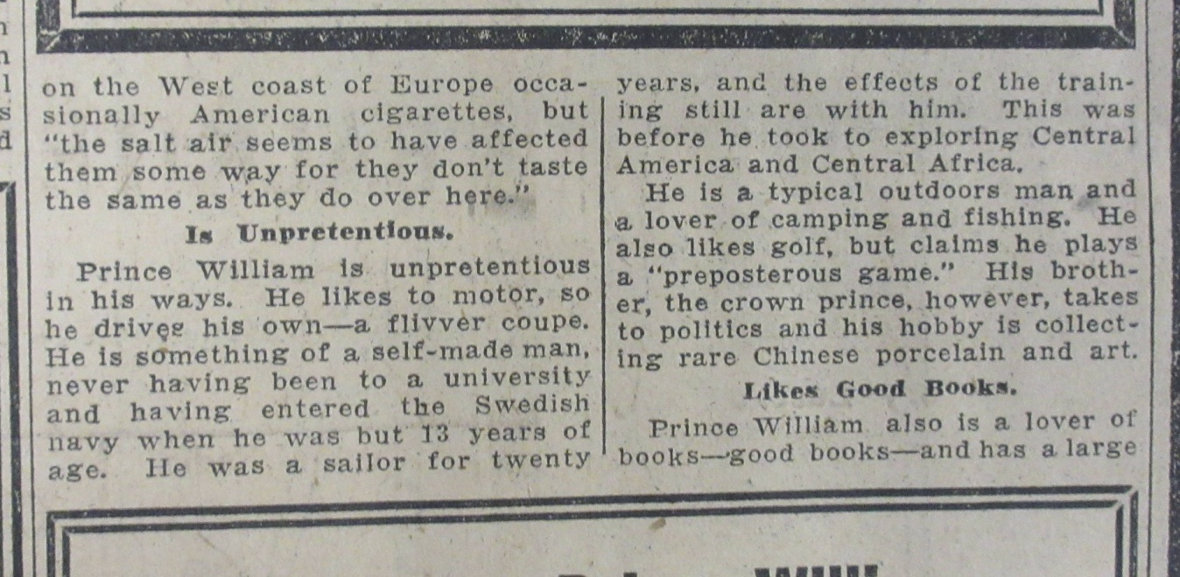

Slide 10
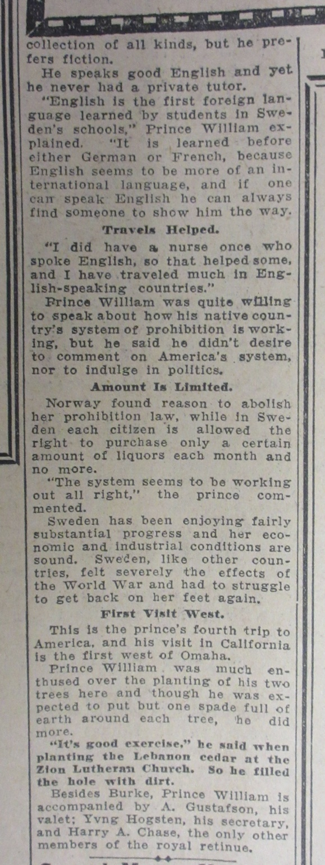
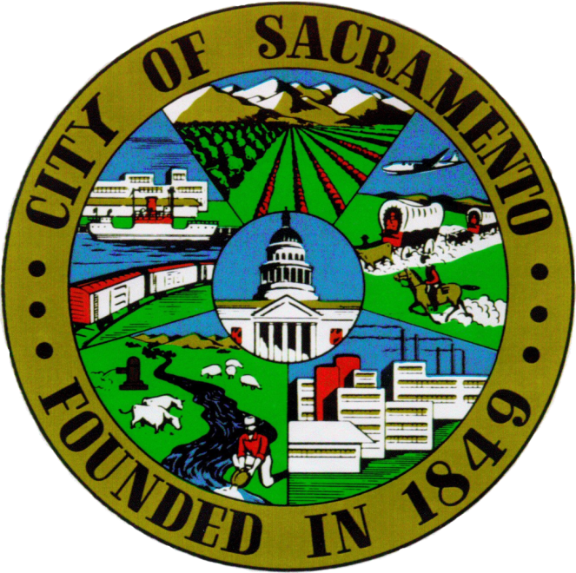
There may be an addendum to the Prince‘s US visit depending on what we learn from the Royal Collections Department in Stockholm.

Slide 11
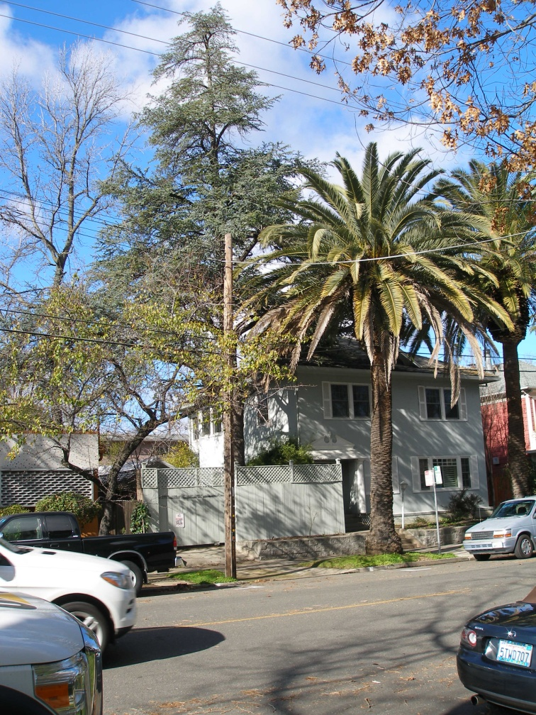
Photos of the Cedar of Lebanon at 1320 25th Street taken in 1985 by Henry Hjersman and in 2017 by Chuck Johnson, members of Monitor Lodge #218

